Slide 1
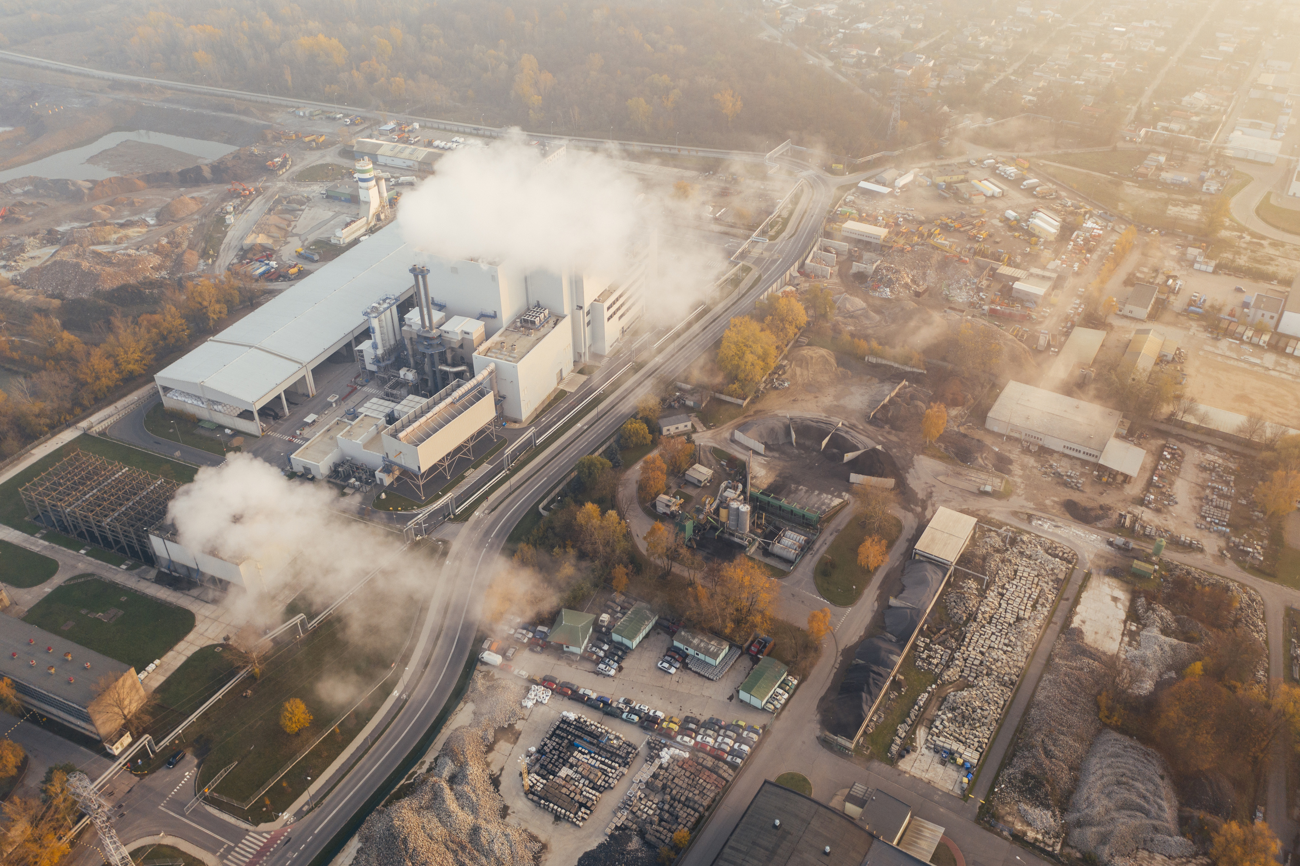


Overview and Global Frameworks on Low Carbon Infrastructure
Module 1: Introduction to Carbon Urban Infrastructure
Shabnam Bassi
Director, Sustainable Buildings, The Energy & Resources Institute (TERI) and Deputy CEO & Secretary, GRIHA Council

Slide 2
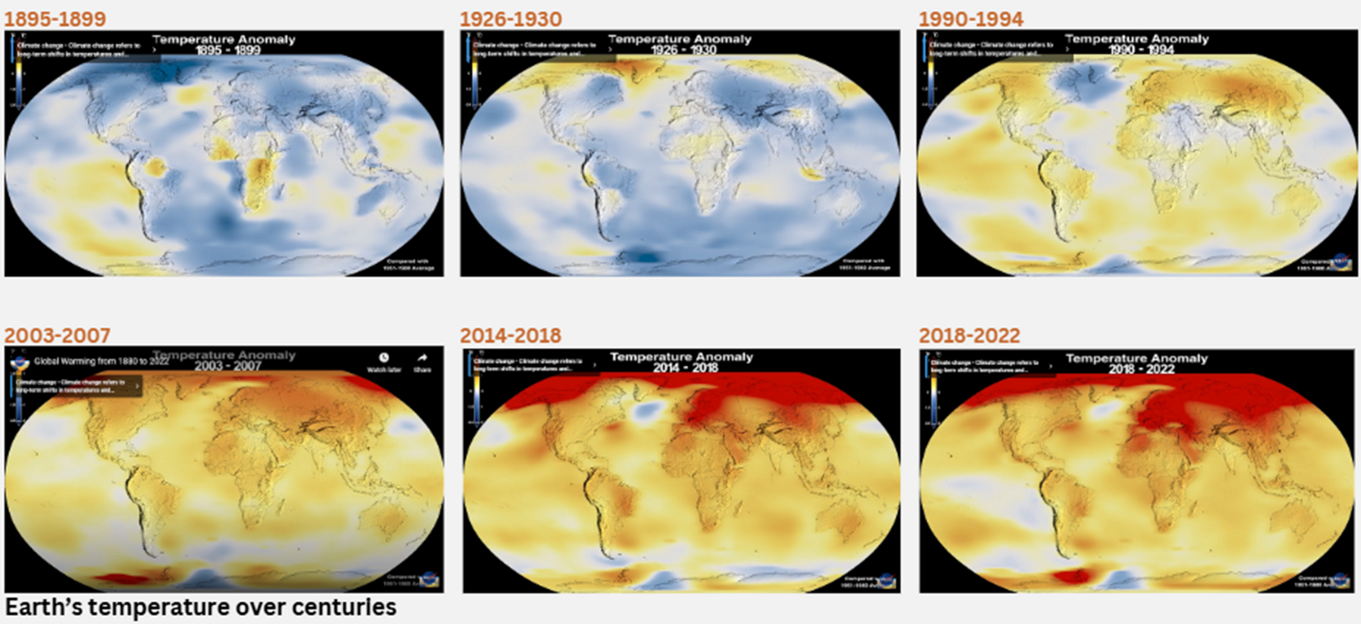
Context
Notes:
These are NASA generated images of our planet Earth. The first recorded imagery here is from 1895. And we started to move ahead in time, the temperature on the planet started to rise significantly – i.e. Global Warming - the phenomenon responsible for all climate change discussions.
The climate crisis that we are in, is induced by anthropogenic activities that have had detrimental impact on nature. The planet is heating up and as we all are aware, 2024 was the hottest year on record, and maybe the coldest of the future. Every year we are seeing increased temperatures.

Slide 3

Consequences
Increased Global Temperatures
Diminishing Arctic Ice
Biodiversity Loss
Melting Glaciers
Frequent Natural Extremities
Adverse Effect on Human Health
Rising Sea Levels
Droughts
Erratic Weather Patterns
Notes:
Increase in global temperatures have led to the melting of glaciers and a rise in the sea level. Increased temperatures will lead to higher evaporation rates which will influence the water cycle accordingly, causing wet areas/regions to get more rain and drier areas will face droughts leading to frequent extreme weather events. This will further lead to alterations in the natural resource base (forests/biodiversity, agriculture, water resources) and will consequently affect people’s livelihoods. Human health will also be impacted with higher temperatures; with children, the elderly and marginalised communities are likely to be more vulnerable.
While having said that, recent events in Los Angeles — The Palisades Fire, the largest of six active blazes in the Los Angeles region — have killed at least 24 people and burned more than 40,000 acres — an area bigger than San Francisco — according to Cal Fire, with flames claiming more than 12,300 structures and displacing tens of thousands. Paris Hilton, Mandy Moore, Mel Gibson, Eugene Levy, James Woods, Chris Pratt and many more Hollywood A-listers have lost their homes. This also is an indication that with the climate threat that we face — it is only a matter of time before it won’t have any marginalisation barriers — geographic or economic — till everyone on planet Earth gets affected.

Slide 4
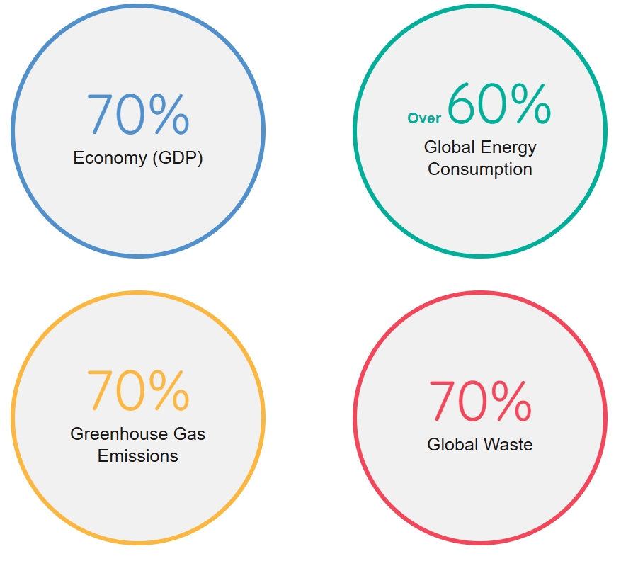
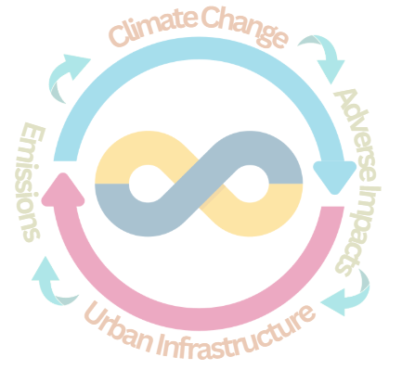
Cities
& Climate Change
2-3%
land area under cities
globally
Source: https://habitat3.org/the-new-urban-agenda/#:~:text=The%20New%20Urban%20Agenda%20represents,both%20developing%20and%20developed%20countries.
Notes:
Cities are home to over 56% of the global population, account for over 70% of the global gross domestic product (GDP). However, cities occupy only about 2-3% of the total land area globally. Despite the lesser footprint, cities are a key contributor to climate change, as urban activities are major sources of greenhouse gas emissions.
Estimates suggest that urban areas are responsible for over:
60% energy consumption,
70% waste generation,
over 70% in global CO₂ emissions;
with the transport and buildings being among the largest contributors (IPCC, 2022).
As highlighted in the previous slide, rising global temperatures have caused sea levels to rise, increases the number of extreme weather events such as floods, droughts and storms, and increases the spread of tropical diseases.
All these have cost-intensive impacts on cities' basic services, infrastructure, housing, human livelihoods and health.
It is a vicious cycle – one where infrastructure development activities lead to adverse effects on Climate Change, and effects of Climate Change causes damage to, and loss of, infrastructure.

Slide 5
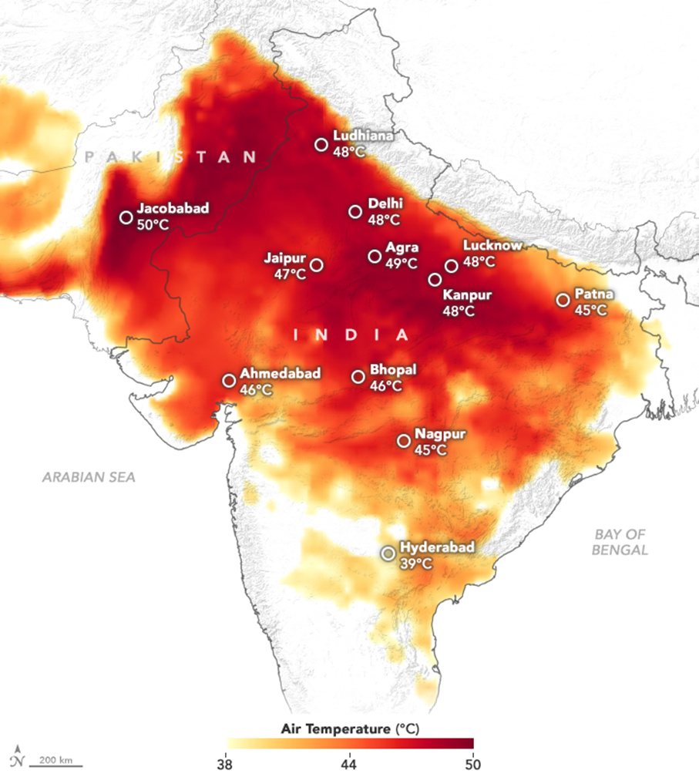
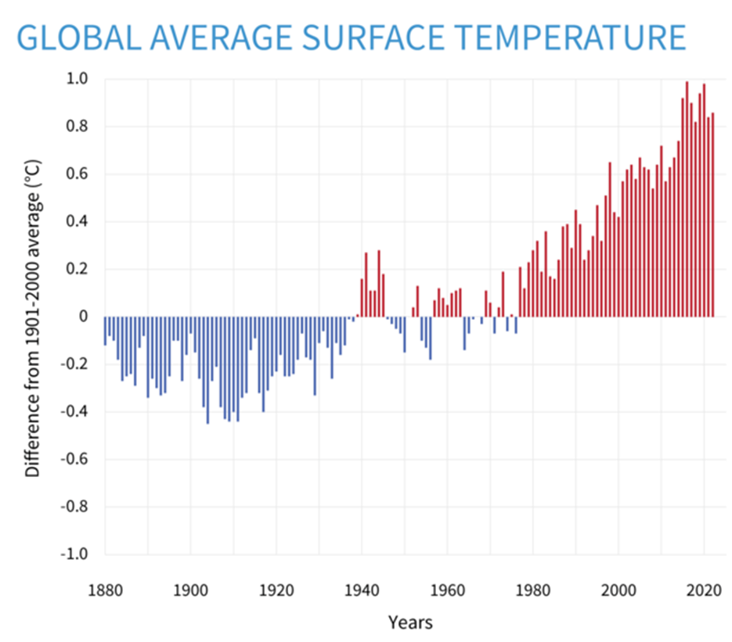
Impact of Climate Change
in Urban Areas
NASA map shows temperatures across much of India and Pakistan on June 10, 2019 (Delhi reached 48°C)
Notes:
Global average temperatures have been increasing, not-so-gradually anymore. The impact of climate change on cities due to rising average temperatures is profound, leading to more frequent and intense heatwaves, increased energy demand for cooling, and a strain on urban infrastructure.
Higher temperatures exacerbated air pollution, affected public health, particularly vulnerable populations, and intensified the urban heat island effect, where cities are significantly warmer than surrounding areas.
These heat stresses can disrupt water resources, increase the risk of flooding, and damage infrastructure, making cities more vulnerable to climate-related disasters.

Slide 6
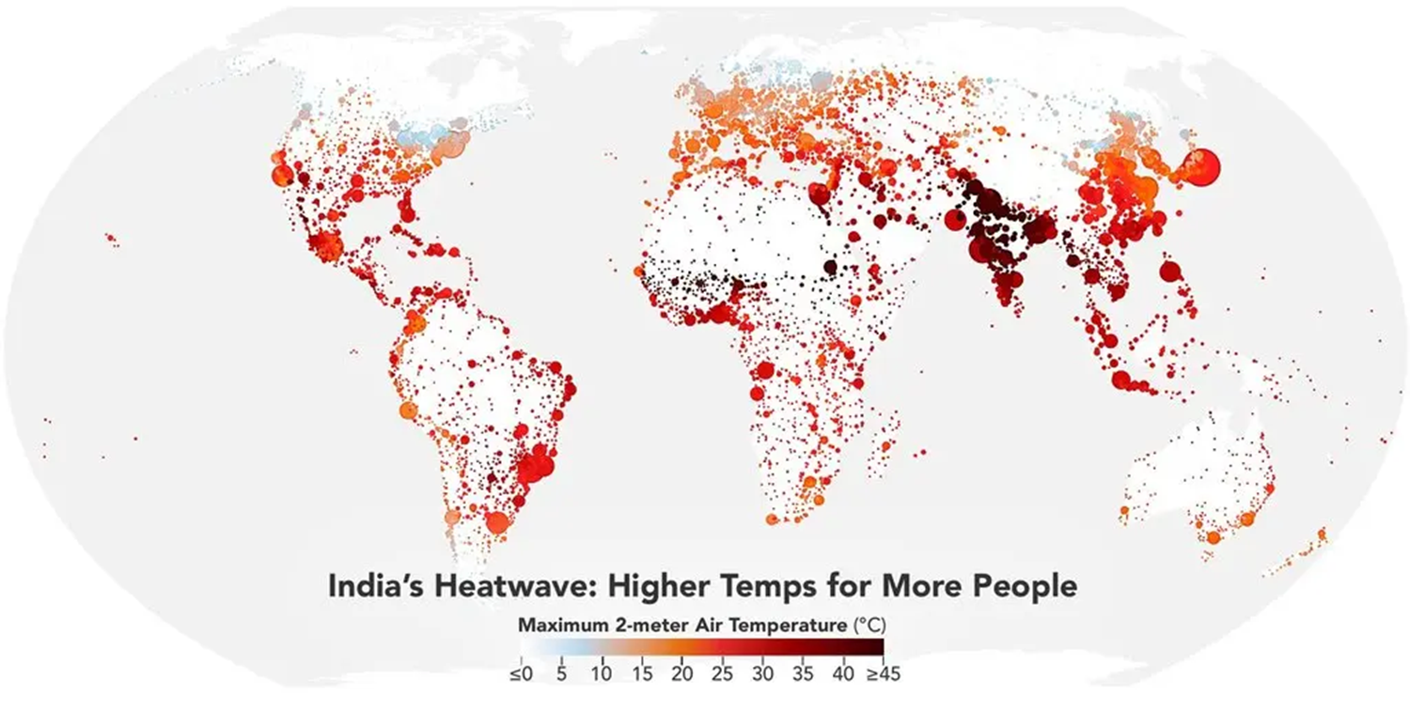
The urgency of addressing carbon emissions in EMDEs is escalated due to the dual pressures of development needs and climate resilience.
Under the current trajectory, the average temperature in India is projected to rise by 3.5 degree Celsius by the end of this century
Notes:
Taking the example of India, if we continue with the same patterns and business-as-usual, then the projected average temperature rise in India is projected to rise by 3.5° Celsius by century’s end as per one of the news articles in NYtimes.
The world is aware that most of the climate change is attributed to the emissions from the US and Europe. But how it affects the future will be guided largely by how Emerging Market and Developing Economies (EMDEs) develop. India is one of the prominent EMDEs, which will have a significant contributory role to play because we are one of the largest economies. Our emissions will certainly grow with our development. But how quickly and how much the emissions grow will be primarily dominated by how quickly we can move away from coal burning. But in the current circumstances, this is the anticipated temp rise in India.
Hence, the need for urgency in cities to adopt resilient, low-carbon solutions to mitigate and adapt these effects. And this urgency of addressing carbon emissions in EMDEs is more crucial due to the dual pressures of development needs and climate resilience.

Slide 7
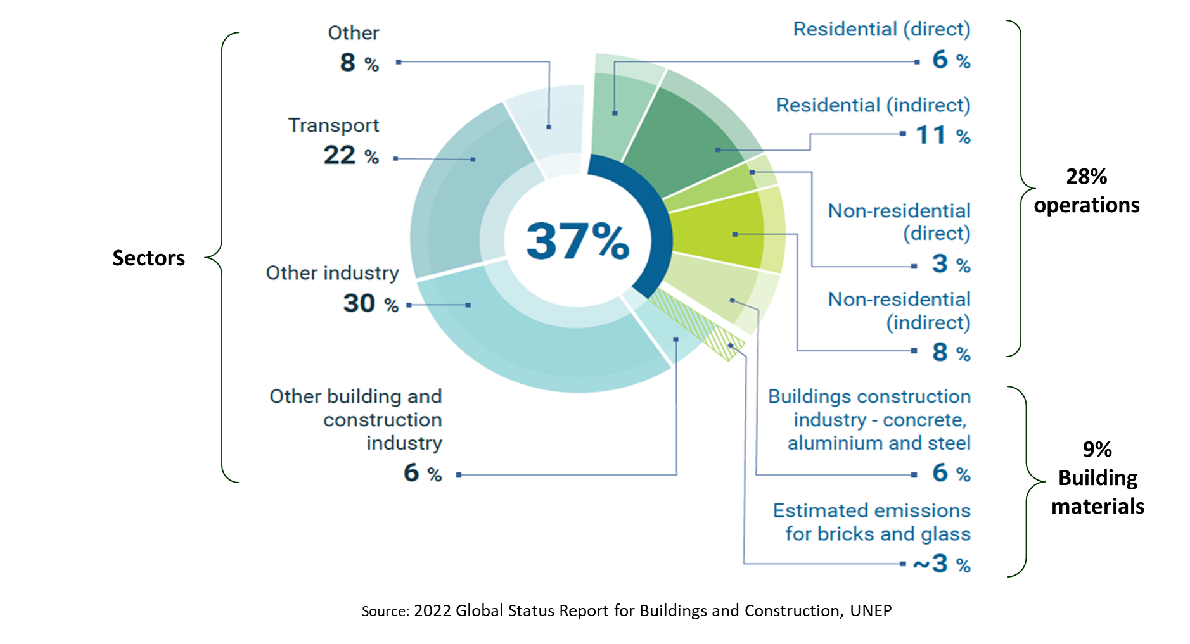
Impact of Urban Infrastructure & Cities
in Climate Change
Notes:
Why is building industry important in all of these carbon emissions and climate change talks?
Because we are one of the largest emitters. If you see, the construction industry and buildings sector is responsible for almost 40% carbon emissions.
The built environment sector has a vital role to play in responding to the climate emergency, and addressing upfront carbon is a critical and urgent focus.
Buildings and construction industry represent around 37 per cent of global operational energy and process-related CO2 emissions.
Around 28% is the operational energy use, 19% of which is attributed to electricity requirements and 9% is the direct use of fossil fuels.
Talking about construction stage: 9% of the emissions happen due to in manufacturing of concrete, steel and aluminium, and then bricks and glass.
Therefore, advancing techniques that reduce the emissions from concrete and steel would lead to a fall in embodied emissions for newly constructed buildings
Further, there is also a strong need to reduce the demand for materials and reuse construction materials more effectively.

Slide 8
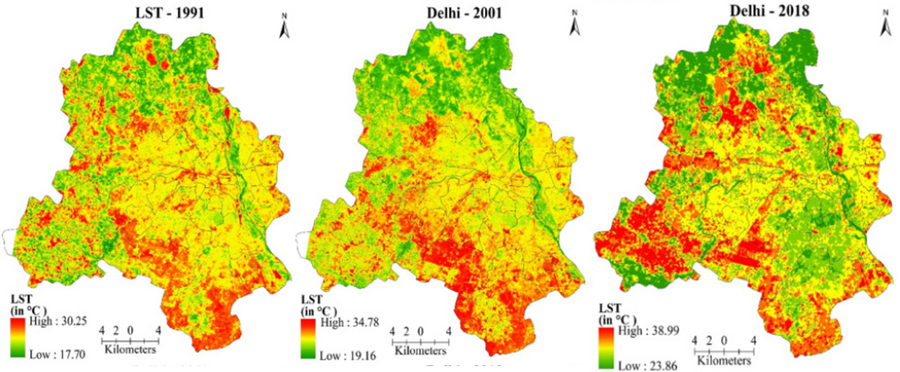
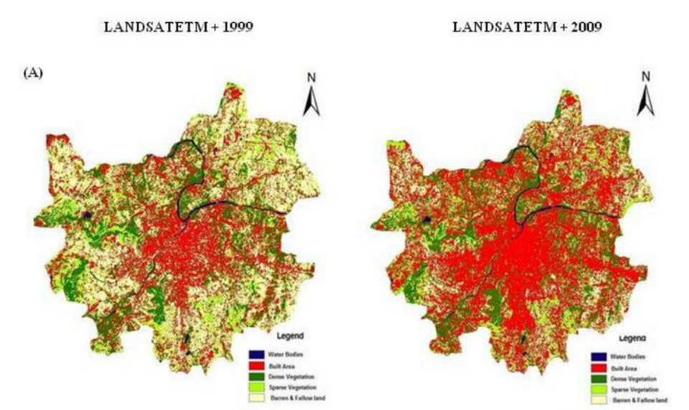
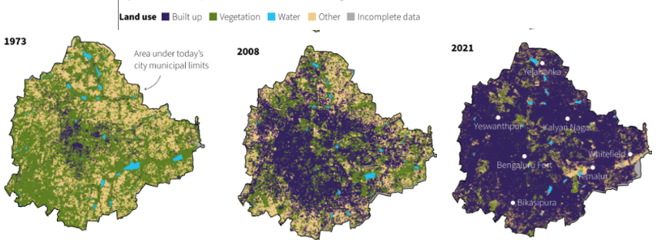
Urban
Growth
Delhi
https://www.sciencedirect.com/science/article/abs/pii/S2212095521002820
Bengaluru
Pune
https://www.researchgate.net/figure/Landuse-Landcover-Changes-in-Pune-City_fig3_264084683
https://www.reddit.com/r/india/comments/xfip1p/in_the_early_70s_more_than_68_of_bengaluru_was/#lightbox
Notes:
With rampant construction happening all around, the situation is going to get worse.
In the past few decades, we have built tremendously to meet the demands of our growing population. This has led to increased built up area, decreased green cover which further led to increased temperatures of our cities owing to the construction and operations of our building and infrastructure.
These are topographical maps of 3 major Indian cities – Delhi, Pune and Bengaluru – showing the increasing built ups, decreasing vegetation and water bodies over the years.

Slide 9
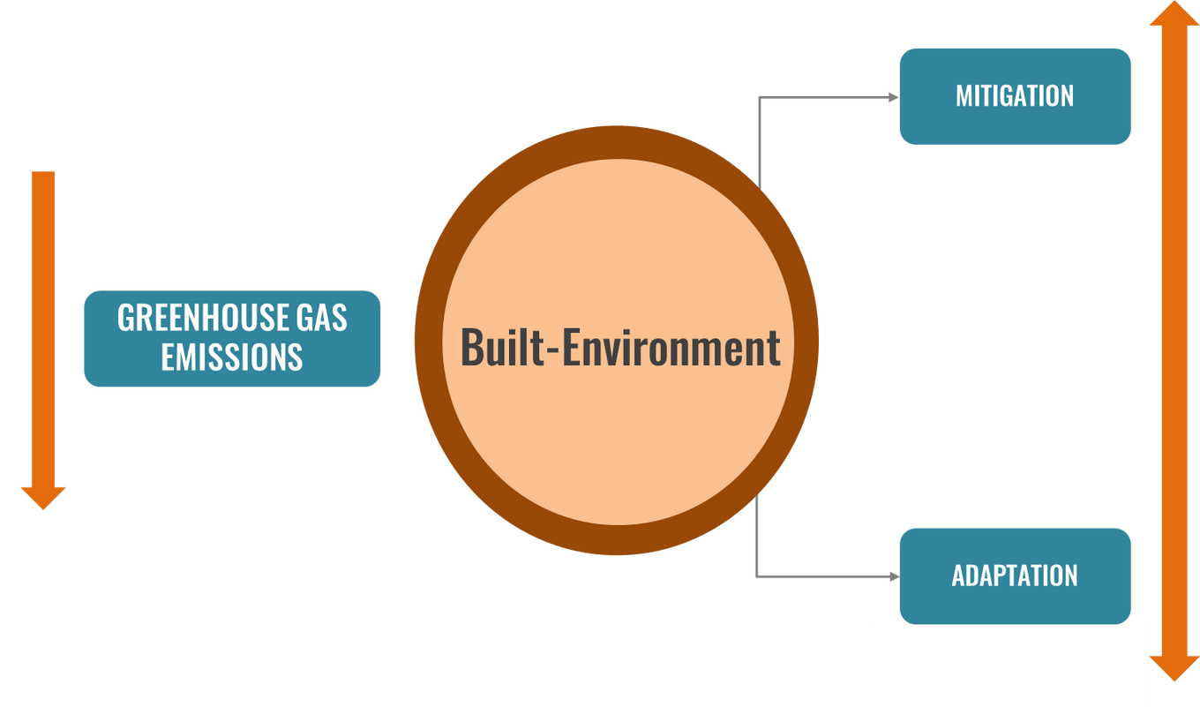
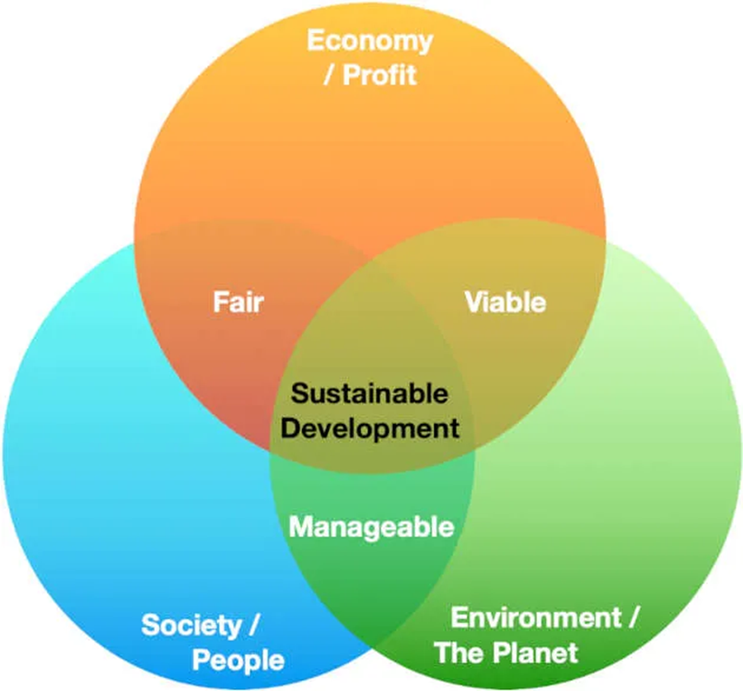
Climate Action in the Built Environment
RESILIENCE
The response measures to combat climate change can be categorised into mitigation and / or adaptation.
‘Mitigation’ is reducing GHG emissions, while ‘Adaptation’ is dealing and coping with the impacts of climate change.
Notes:
The response measures to combat climate change in the built environment can be categorised into:
Mitigation, and / or
Adaptation
‘Mitigation’ is reducing GHG emissions, while ‘Adaptation’ is dealing and coping with the impacts of climate change.
We need to build not just to reduce carbon emissions, but also to adapt to the fast-changing climate conditions. At the same time, infrastructure and cities should be prepared for the changing weather patterns such as typhoons, cyclones, flooding, earthquakes. Therefore, there is a need to build resilient structures. Now is the time to build sustainable resilient infrastructure for human health and environments health.
Sustainable or low carbon infrastructure
care of the environment,
can sustain on their own,
take care of affordability as well as about the society (focusing on equitable access)

Slide 10


Global Commitments for
Climate Action
Reduce greenhouse gas emissions by an average of 5% below 1990 levels
The Kyoto Protocol was superseded by the Paris Agreement, which entered into force in November 2016.
Limiting global warming to under 2 °C above preindustrial levels
Notes:
Acknowledging this escalated threat of Climate Change and Global Warming that looms the future, various commitments have been made by coming together of countries. However, the significant ones are as highlighted here.
The Kyoto Protocol, a significant step towards addressing global warming and uptaking actions, was adopted in 1997 and entered into force in 2005. It was an international treaty aimed at combating climate change by reducing greenhouse gas emissions. It was the first significant global agreement to set legally binding targets for developed countries to cut their emissions of carbon dioxide and other greenhouse gases, acknowledging their historical responsibility for climate change. Although, all targets under the Kyoto Protocol were not met, this was a pivotal step in raising global awareness and setting the stage for future climate agreements, like the Paris Agreement, in the ongoing effort to address global warming.
The Kyoto Protocol was superseded by the Paris Agreement, which entered into force in November 2016.
The Paris Agreement, adopted in 2015 during the UN Climate Change Conference (COP21) in Paris, is a landmark international accord aimed at limiting global warming to well below 2°C above pre-industrial levels, with efforts to restrict the increase to 1.5°C. The Paris Agreement involves commitments from all countries, both developed and developing, to reduce greenhouse gas emissions and enhance climate resilience. Each nation sets its own targets, known as Nationally Determined Contributions (NDCs), and is expected to update and strengthen these targets over time. The agreement also emphasizes financial and technical support for developing countries to tackle climate change impacts. By fostering a collaborative and flexible approach, the Paris Agreement seeks to unite global efforts in combating climate change and promoting sustainable development.

Slide 11


Global Commitments for
Climate Action
An example of climate change mitigation and adaptation is The 2030 Agenda for Sustainable Development, adopted by all United Nations Member States in 2015.
It provides a shared blueprint for peace and prosperity for people and the planet, now and into the future.
At its heart are the 17 Sustainable Development Goals (SDGs), which are an urgent call for action by all countries - developed and developing - in a global partnership.
Notes:
Leaders from countries all over the world have been meeting regularly to consider what can be done to reduce global warming and to cope with the temperature increases that are taking, and will take, place.
One example of climate change mitigation and adaptation is The 2030 Agenda for Sustainable Development, adopted by all United Nations Member States in 2015. It provides a shared blueprint for peace and prosperity for people and the planet, now and into the future. At its heart are the 17 Sustainable Development Goals (SDGs), which are an urgent call for action by all countries - developed and developing - in a global partnership. They recognize that ending poverty and other deprivations must go hand-in-hand with strategies that improve health and education, reduce inequality, and spur economic growth – all while tackling climate change and working to preserve our oceans and forests. SDG 13 directly aims to address "Climate Action", while many other SDGs overlap and share synergies to combat climate change.

Slide 12
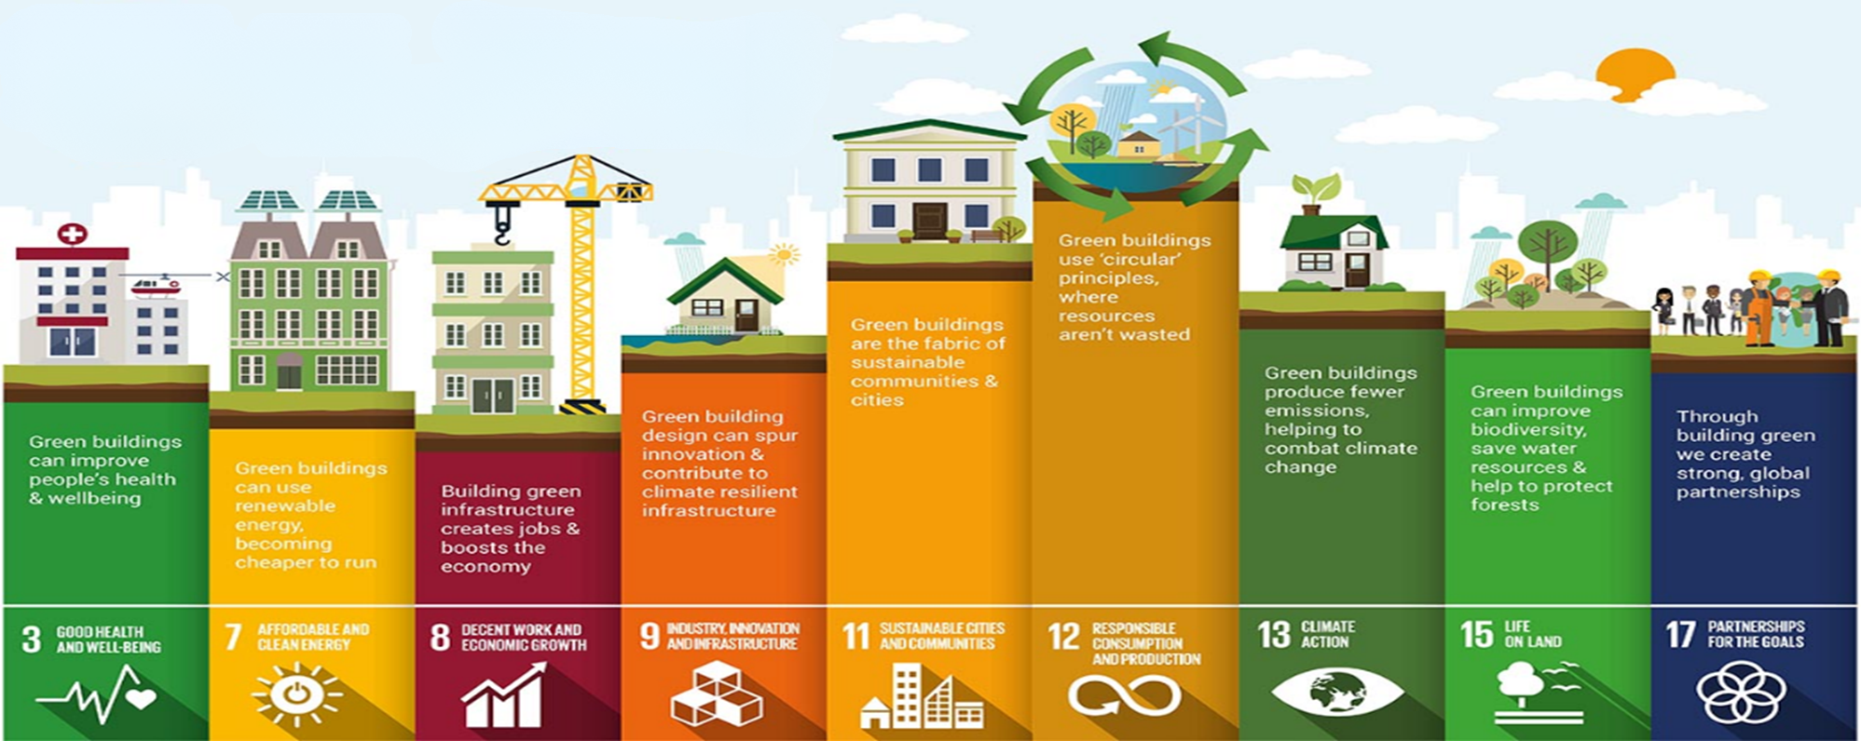
SDGs and Infrastructure
9 out of the 17 SDGs directly target the built sector and the urgent steps needed to be taken for its contribution towards sustainable development.
Notes:
9 out of the 17 SDGs directly target the building sector and the urgent steps needed to be taken for its contribution towards sustainable development.
Infrastructure is central to the achievement of multiple SDGs, as it forms the foundation for essential services like clean water, energy, transportation, housing, and sanitation. By focusing on sustainable, low-carbon, and resilient infrastructure, countries can make significant progress toward the 2030 Agenda for Sustainable Development. Infrastructure is not just about physical buildings and roads; it is about creating systems that support economic growth, environmental sustainability, and social inclusion.
For instance, SDG 3 i.e. Good Health and Well being is based on the consideration that built environments largely impact human health and wellbeing, hence materials used in the buildings, occupant comfort and wellbeing must be kept in mind to fulfil this SDG.

Slide 13
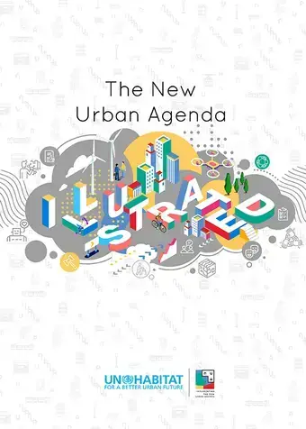

Global Commitments for
Climate Action
Governance
Sustainable Urban Development
Social Inclusion
Resilience
The New Urban Agenda (NUA), adopted in 2016 at the United Nations Conference on Housing and Sustainable Urban Development (Habitat III) in Quito, Ecuador, outlines a global vision for creating more sustainable, inclusive, and resilient urban spaces.
Notes:
The New Urban Agenda (NUA), adopted in 2016 at the United Nations Conference on Housing and Sustainable Urban Development (Habitat III) in Quito, Ecuador, outlines a global vision for creating more sustainable, inclusive, and resilient urban spaces. The NUA emphasizes the importance of urbanization as a driver of social, economic, and environmental progress. It provides a framework for addressing the challenges of rapid urban growth, urban poverty, inequality, and environmental degradation.
The NUA calls for policies and actions that promote:
Sustainable urban development, including resource-efficient use of land, infrastructure, and energy.
Social inclusion and affordable housing, aiming to ensure that all urban residents, particularly marginalized groups, have access to decent living conditions and opportunities.
Resilience to the impacts of climate change and natural disasters, through risk-reduction strategies and adaptive urban planning.
Good governance at all levels, fostering participation, transparency, and accountability in urban decision-making processes.
It also stresses the need for integrated approaches that connect urban and rural areas, as well as the active involvement of all stakeholders—governments, private sectors, civil society, and communities—in the planning and management of urban spaces.
In essence, the NUA sets a global agenda for creating cities that are sustainable, inclusive, and responsive to the challenges of the 21st century.

Slide 14
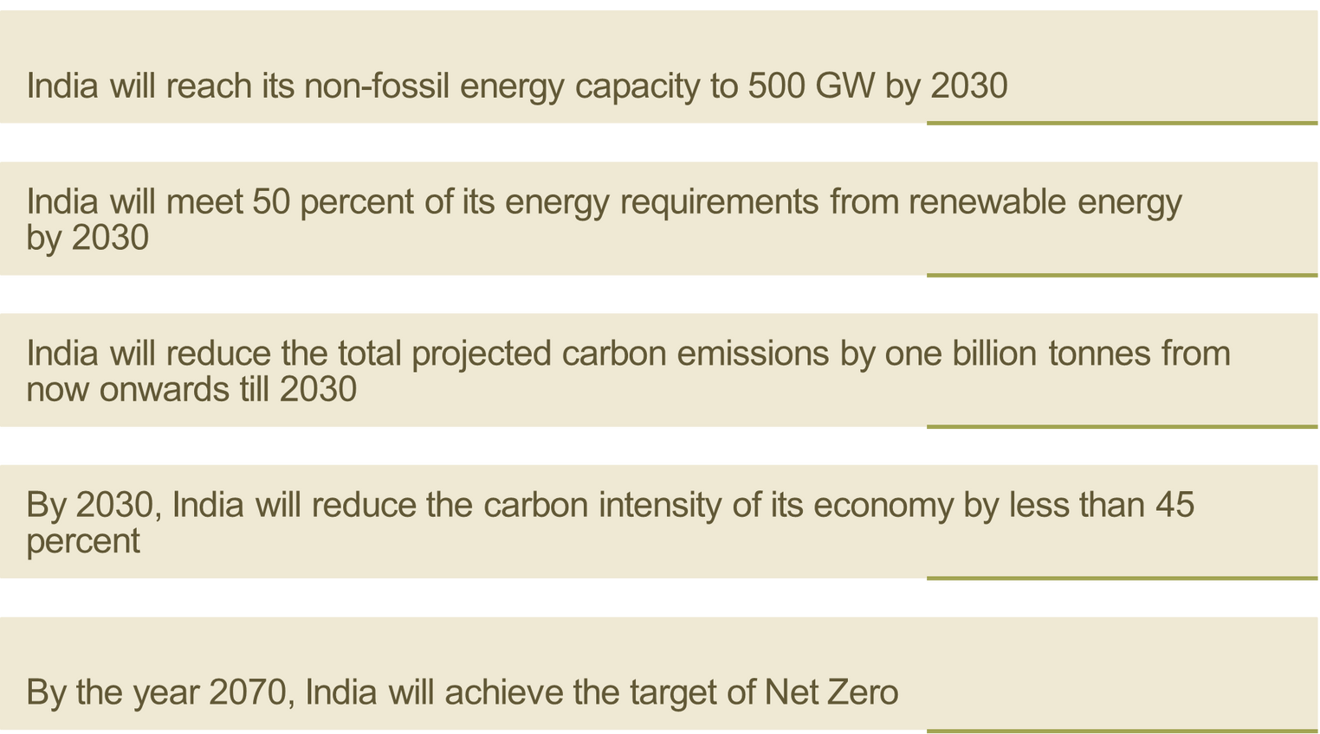

National Commitments for
Low Carbon Infrastructure
India’s Intended Nationally Determined Contributions (INDCs)
Targets for reducing carbon intensity, increasing renewable energy capacity, and improving energy efficiency.
India’s Commitment at COP 26 via five essential commitments, known as Panchamrit
that outlines a step-wise plan for a greener India
The 2070 Commitment
Panchamrit
Targets
Notes:
India's Panchamrit (five nectar elements), unveiled at the 2021 UN Climate Change Conference (COP26), is a five-point climate action plan aimed at significantly enhancing the country's commitment to addressing climate change. The plan includes ambitious goals of:
Reaching 500GW non-fossil energy capacity by 2030.
50% of its energy requirements from renewable energy by 2030.
Reduction of total projected carbon emissions by one billion tonnes from now to 2030.
Reduction of the carbon intensity of the economy by 45% by 2030, over 2005 levels.
Achieving the target of net zero emissions by 2070.
This initiative reflects India’s dedication to balancing economic growth with environmental sustainability and highlights its role in global climate leadership by contributing to international efforts to mitigate climate change and build resilience.

Slide 15
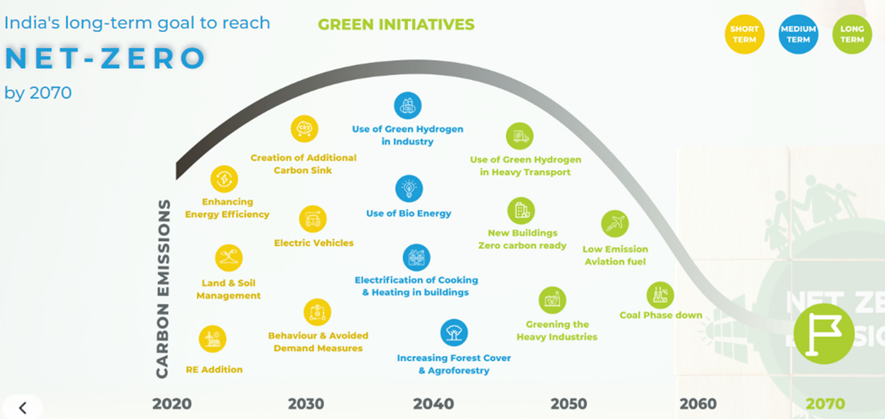
National Commitments for
Low Carbon Infrastructure
Notes:
Climate Action cannot yield results in a day, i.e. it will take drastic measures to even achieve our committed goals of carbon neutrality by 2070. This is a long-term goal and commitment, that has to be paved through smaller, intermediate goals. This image showcases what action needs to be done and these various initiatives are divided under: Short-Term, Medium-Term and Long-Term goals to reach carbon neutrality by 2070.

Slide 16
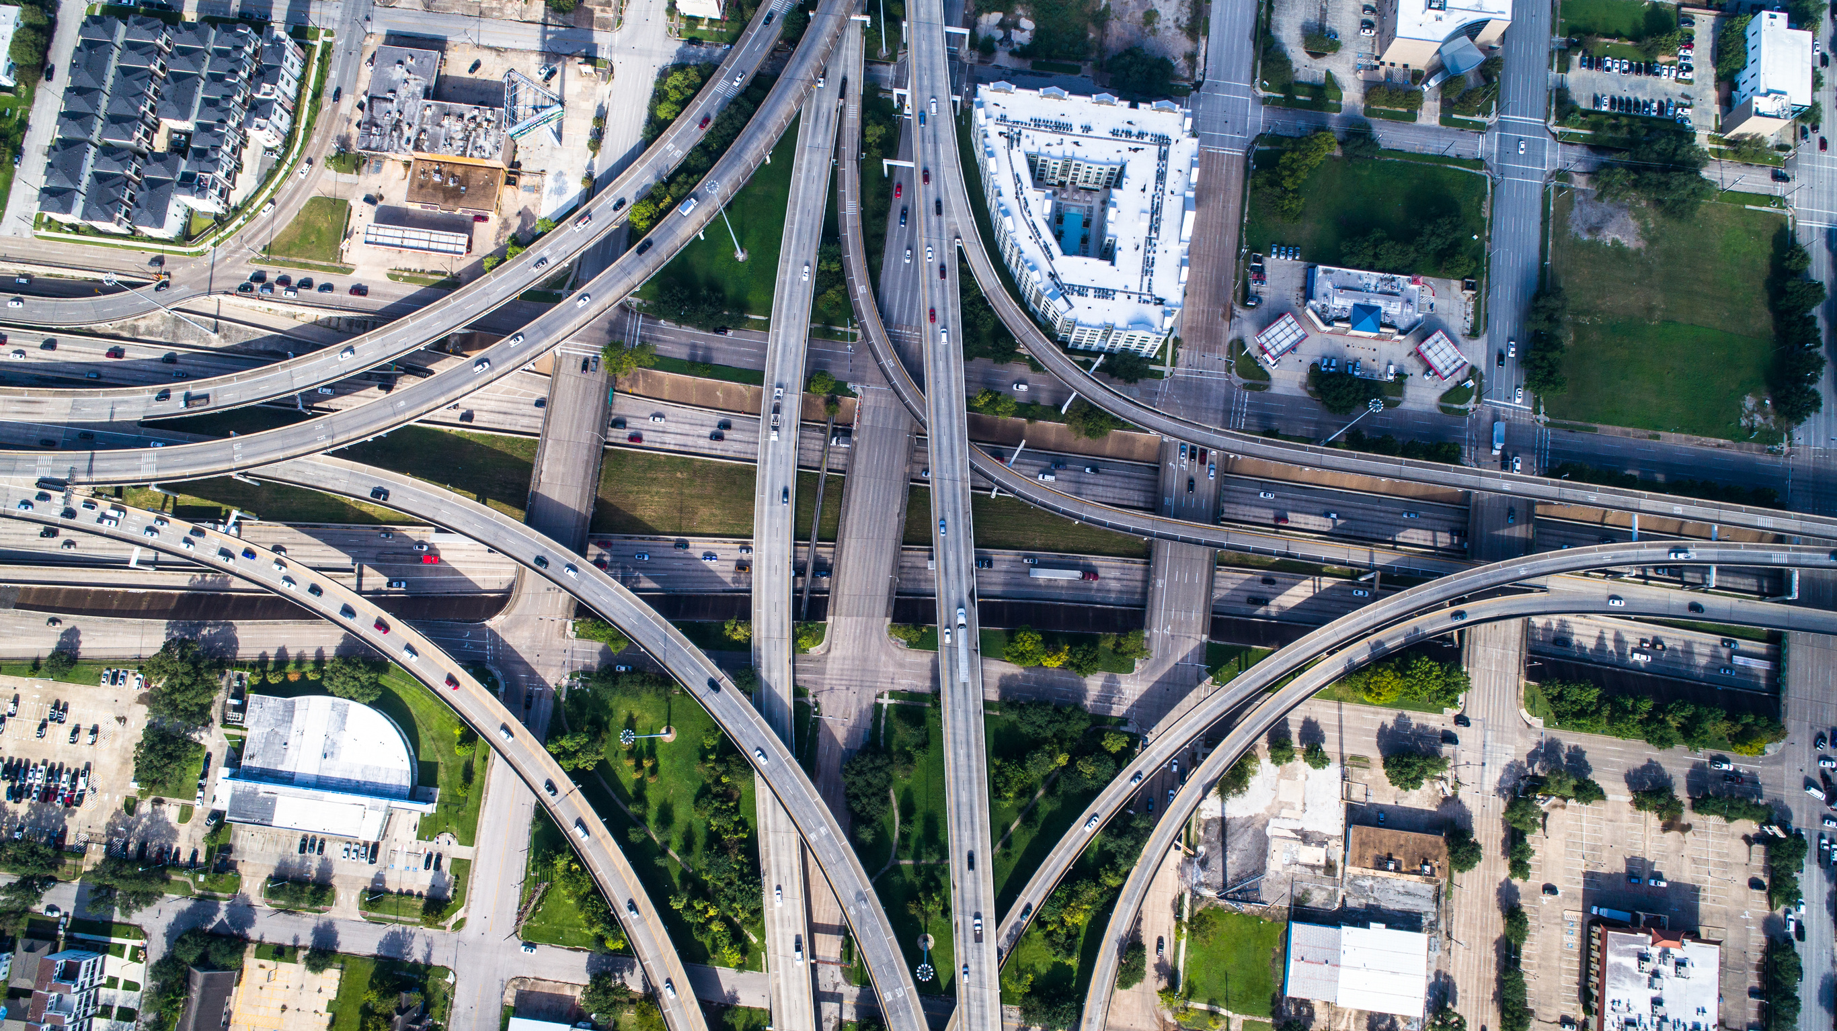





Urban Infrastructure
URBAN INFRASTRUCTURE COMPONENTS
Urban Planning
Waste Management
Water Systems
Transport
Energy Systems
Notes:
Urban infrastructure as an integrated network of physical structures and systems that serve cities and towns. The following comprise primary elements of infrastructure:
urban planning
water systems
energy systems
transport
waste management
With 70% of global emissions being attributed to urban infrastructure, there is a dire need to transition to low carbon emission infrastructure.

Slide 17
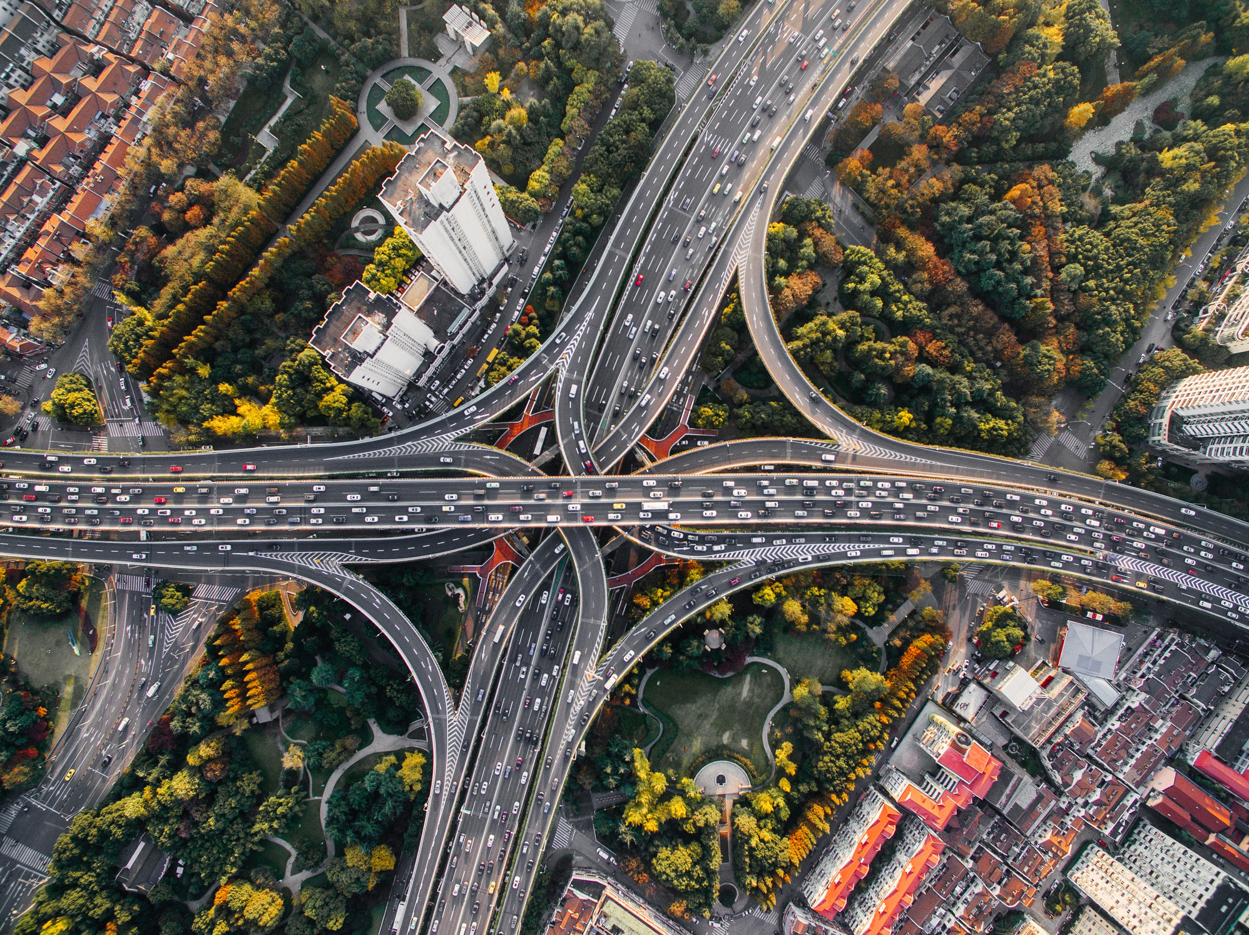
Urban Infrastructure
, but
Low Carbon
URBAN INFRASTRUCTURE COMPONENTS
Urban Planning
Green Buildings,
Increased Green Cover, Materials
Waste Management
Waste-to-Energy
Circular Economy
Resource Recovery
Water Systems
Recycled Water & Rainwater Harvesting
Transport
Energy Systems
Biofuels / EVs / TOD / NMT (cycling & walking)
Grid Decarbonisation & RE Integration
Notes:
Systems and facilities that are designed to reduce or eliminate greenhouse gas emissions compared to traditional systems can be defined as low carbon infrastructure. The same components may be addressed as:
urban design: Green Buildings, Decarbonising Habitats & Infrastructure
water systems: Recycled Water & Rainwater Harvesting
energy systems: Grid Decarbonisation & RE Integration
transport: Biofuels / EVs / TOD / NMT (cycling & walking)
waste management: Waste-to-Energy, Circular Economy

Slide 18
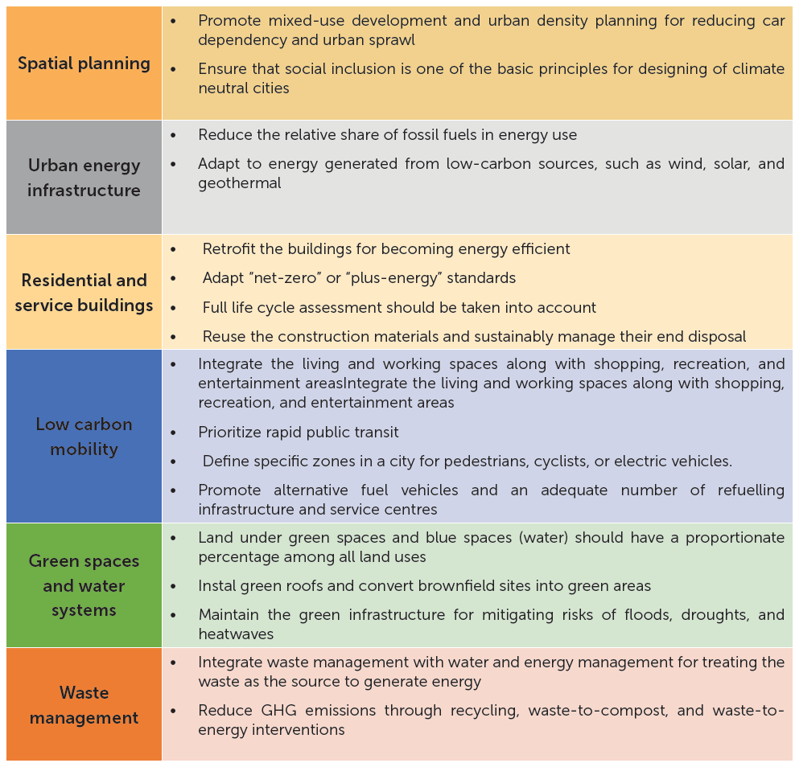
Interventions for
Carbon Neutral Cities
Source: Golubchikov, O., 2011. Climate Neutral Cities: How to Make Cities Less Energy and Carbon Intensive and more
Resilient to Climatic Challenges. New York and Geneva: United Nations, Economic Commission for Europe
(UNECE).

Slide 19
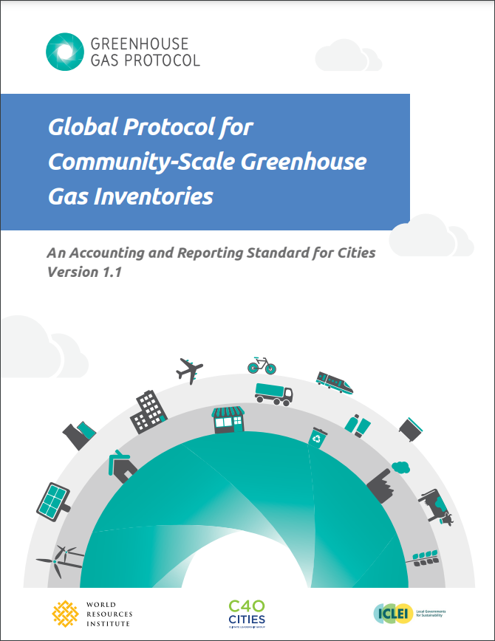
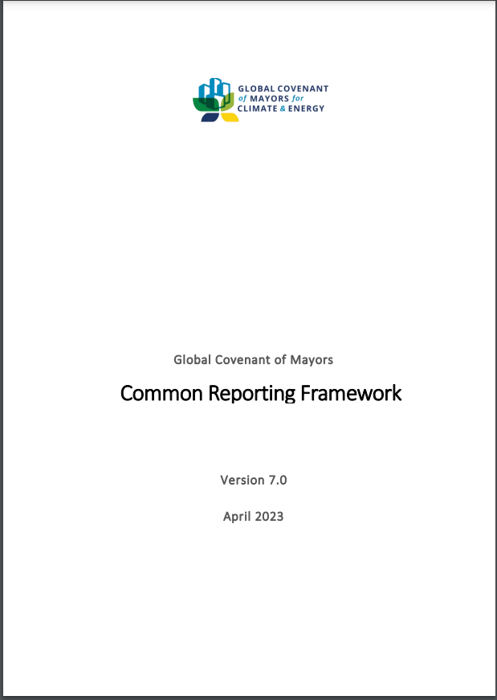
Frameworks for
Low Carbon Infrastructure
Source:https://ghgprotocol.org/sites/default/files/standards/GPC_Full_MASTER_RW_v7.pdf
Source: https://www.globalcovenantofmayors.org/wp-content/uploads/2023/11/CRF7-0-2023-09-14-final.pdf
Notes:
Cities are the global centres of communication, commerce and culture. They are also a significant, and growing, source of energy consumption and greenhouse gas (GHG) emissions. A city’s ability to take effective action on mitigating climate change, and monitor progress, depends on having access to good quality data. Planning for climate action begins with developing a GHG inventory. An inventory enables cities to understand the emissions contribution of different activities in the community.
Over the past two decades, several institutions have been active in establishing methodologies for estimating urban GHG emissions (Kikuchi, Bristow, and Kennedy, 2009). Two prominent methodologies at the city scale are:
the Global Protocol for Community-Scale Greenhouse Gas Emission Inventories, or GPC framework, by World Resources Institute (WRI), C40 Cities Climate Leadership Group (C40 Cities) and ICLEI - Local Governments for Sustainability (ICLEI)
the Common Reporting Framework by the Global Covenant of Mayors for Climate and Energy (GCoM)
Though the inventories differ in structure and reporting formats, they generally use common approaches and terminologies at the city level, that are important for climate change policymakers and decision-makers to understand. Next slide for explanation.

Slide 20
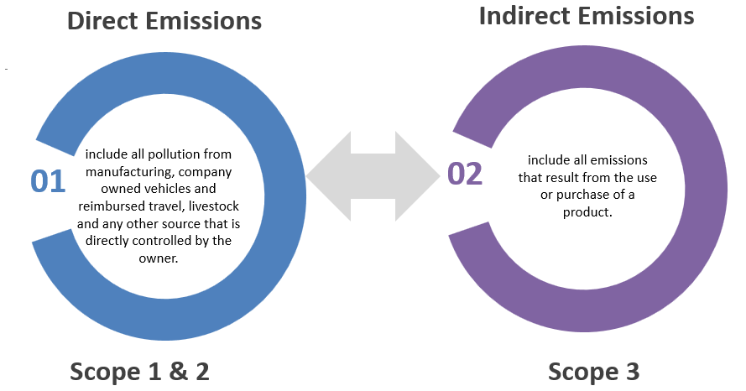
Outline of Reporting Framework
for Low Carbon Infrastructure
Defining Geographical Boundaries
Identifying Emission Sources
Quantifying Emissions and Composing Inventory
Aggregating City Inventories
Goal Setting and Progress Tracking
Steps for creating a GHG inventory at the city level in the GPC framework
Source: Fong, W.K. and C40, M.D., 2014. Global protocol for community-scale greenhouse gas emission inventories.
Notes:
Defining Geographical Boundaries
Defining a geographical boundary for composing a GHG inventory is the first step towards GHG accounting at the city level. Cities need to define a geographic boundary that will mark the spatial perimeter of the inventory’s boundary, which may in turn align with the administrative boundaries of ward, city, or metropolis depending on the purpose of the boundary. The target boundary should be consistent with all the emission sources included in the GHG emissions inventory, with the possibility to exclude sources that are not controlled by the local government.
Identifying Emission Sources
For this step, cities need to identify existing and potential sources of GHG emissions from different sectors and geographical areas for the base year. To increase the credibility of GHG accounting, the GPC framework segregates this scoping exercise into the following two distinct but complementary components:
Emission sources based on different sectors/city activities
Emission sources based on geographical origin/boundary
The emission sources based on geographical origin/boundary are classified into “Scopes”, depending on the location of generation of emissions:
Scope 1: GHG emissions from sources located within the city boundary.
Scope 2: GHG emissions occurring as a consequence of the use of grid-supplied electricity, heat, steam, and/or cooling within the city boundary.
Scope 3: All other GHG emissions that occur outside the city boundary as a result of activities taking place within the city boundary.
Quantifying Emissions and Composing Inventory
For most GHG accounting frameworks, cities need to estimate or quantify GHG emissions by multiplying activity data by an emission factor associated with the activity being measured. GHG Emissions = Activity Data X Emission Factor.
The activity data and the emission factor defined by the GPC framework are as follows:
Activity data is a quantitative measure of the level of an activity that results in GHG emissions taking place during a given period of time (e.g., volume of gas used, kilometres driven, tonnes of waste sent to landfills, etc.).
Emission factor is a measure of the mass of GHG emissions relative to a unit of activity. For example, estimating CO2 emissions from the use of electricity involves multiplying data on kilowatt hours (kWh) of electricity used by the emission factor (kgCO2/kWh) for electricity, which will depend on the technology and the type of fuel used to generate the electricity.
Ideally, the GHG inventory should cover emissions of seven gases – carbon dioxide (CO2), methane (CH4), nitrous oxide (N2O), hydrofluorocarbons (HFCs), perfluorocarbons (PFCs), sulphur hexafluoride (SF6), and nitrogen trifluoride (NF3). However, GHG emissions data should be reported as metric tonnes of each GHG as well as CO2 equivalents (CO2e) for easy comprehension and interoperability.
Aggregating City Inventories
The various city inventories can be further aggregated at state and national levels to:
improvise the data quality of a national inventory,
quantify the results of implemented city mitigation actions to state or national GHG emission reduction targets, and
Ideate and develop innovative cross-sectoral strategies for GHG mitigation across various cities.
Aggregation of various city inventories can be further accomplished by merging the scope 1 (territorial) emissions of cities, as their inventory boundaries do not overlap geographically.
Goal Setting and Progress Tracking
The subsequent step for the cities following the creation of their inventories relates to goal or target setting for emission reduction. Inventories are generally structured in a manner that defines a baseline year (either financial or the calendar year) for reporting, based on which emission reduction targets are set for years to follow.

Slide 21







Challenges for EMDEs in
Adopting Global Frameworks
Financial Constraints
Inadequate Institutional Capacity
Political and Social Resistance
Equitable Access
Existing Infrastructure lock-in
Technical Skill Limitations
Notes:
Emerging Market and Developing Economies (EMDEs) face both challenges and opportunities in adopting global frameworks for low-carbon infrastructure. These nations are often at the forefront of climate change impacts but are also navigating the complex balancing act of economic development, poverty reduction, and environmental sustainability.
Challenges:
Financial Constraints (high upfront costs): In many Emerging Markets and Developing Economies (EMDEs), limited access to financial resources presents a significant barrier to adopting low-carbon infrastructure. The upfront investment required for transitioning to sustainable solutions, such as renewable energy technologies (solar, wind, etc.), energy-efficient buildings, green transportation systems (electric vehicles, public transit), and low-carbon urban infrastructure, is often much higher than that of traditional, carbon-intensive alternatives. This is particularly problematic for EMDEs, where limited budgets, competing priorities, and insufficient access to financing mechanisms can make it difficult to secure the necessary funds for such long-term investments. Moreover, while the long-term benefits of low-carbon infrastructure include reduced operational costs and environmental impacts, the initial financial burden can deter both public and private sector investments. Without adequate funding support, such as climate finance or green bonds, EMDEs struggle to make the transition to more sustainable and resilient infrastructure systems, which ultimately impedes their ability to meet global climate goals and adapt to the growing challenges of climate change.
Inadequate Institutional Capacity: Weak governance and regulatory frameworks are a significant barrier to the development and scaling of low-carbon infrastructure. Effective implementation of low-carbon strategies requires strong institutional structures, clear regulatory frameworks, and coordinated efforts across multiple sectors. Without these foundational elements, it becomes difficult to align national and local policies with global climate frameworks, such as the Paris Agreement, which calls for substantial investments in sustainable infrastructure. In many EMDEs, there is a lack of technical expertise, insufficient policy enforcement, and fragmented governance that undermines the long-term viability of low-carbon projects. Institutional fragmentation often results in poor coordination between various regulatory bodies, such as those responsible for energy, transport, urban planning, and environmental protection. The absence of an integrated approach to low-carbon development means that efforts in one sector, like renewable energy deployment, may not be aligned with transportation or waste management policies, reducing their overall effectiveness. This siloed approach can lead to inefficiencies, delays, and missed opportunities for synergies between sectors. Additionally, weak institutional capacity often translates to a lack of transparency, accountability, and public trust, which further hinders the successful implementation of low-carbon initiatives. Strengthening governance, improving coordination among departments, and building institutional capacity are crucial for creating an enabling environment that supports sustainable, low-carbon infrastructure development.
Political and Social Resistance: There may be resistance to adopting low-carbon infrastructure due to political, social, or economic interests that benefit from existing high-carbon infrastructure.
Political and social resistance is a significant barrier to adopting low-carbon infrastructure, particularly in regions with strong economic and political ties to high-carbon industries such as coal, oil, and gas.
Powerful interest groups, including fossil fuel companies and associated sectors, may actively oppose the transition to low-carbon solutions because it threatens their financial interests. Political leaders may be reluctant to pursue aggressive climate policies due to concerns over voter backlash or the potential economic impact on key industries in their constituencies.
Social resistance is also a key factor, especially in communities that are heavily dependent on traditional, high-carbon industries. In regions where coal mining, oil extraction, or other carbon-intensive industries are the primary sources of employment, there is often significant fear of job losses and economic disruption if these industries are downsized or phased out in favour of greener alternatives. Workers in these sectors, as well as local businesses that depend on these industries, may resist low-carbon policies because they perceive them as a threat to their livelihoods.
Additionally, there may be a lack of awareness or understanding about the long-term benefits of low-carbon infrastructure, such as cleaner air, reduced health risks, and job creation in emerging green sectors.
Overcoming this resistance requires strong political leadership, clear communication about the benefits of the transition, and targeted support for communities and workers affected by the shift to low-carbon economies. Policies such as re-training programs, job creation in renewable energy sectors, and financial incentives for industries to transition can help reduce resistance and ease the social and economic impact of the transition.
Equitable Access (ensuring accessibility for all social groups): Equity concerns pose a significant challenge to promoting low-carbon infrastructure because marginalized communities may face barriers to accessing affordable, clean technologies. These groups, often already economically disadvantaged, may struggle with the higher upfront costs of green infrastructure, or they may lack the necessary resources, education, and support systems to benefit from sustainable solutions, thereby exacerbating existing inequalities. Without targeted policies that address these disparities, low-carbon initiatives risk reinforcing social divides and leaving vulnerable populations behind, hindering the widespread adoption of sustainable infrastructure. For many developing nations, ensuring energy access for all while transitioning to low-carbon sources is a key concern. This dual challenge of improving energy access while simultaneously decarbonizing energy production can pose as a challenge.
Infrastructure lock-in due to existing systems: Existing infrastructure that are already locked-in would usually be high-carbon systems, such as outdated energy grids or transportation networks. These create strong path dependencies, making it difficult to transition to more sustainable alternatives. Strong path dependencies occur when existing systems and infrastructure, like fossil fuel-based energy grids or traditional transportation networks, become deeply ingrained in society. These systems are costly to replace and often involve established economic, political, and social interests, making it difficult to shift to more sustainable alternatives without overcoming significant barriers.
Technical Skill Limitations (Lack of Technical Knowhow): While low-carbon technologies are advancing, many EMDEs face a shortage of skilled workers and technical expertise needed to implement these solutions at scale. The lack of training in renewable energy, energy-efficient systems, and sustainable infrastructure limits the ability to adopt and maintain these technologies locally. Additionally, reliance on imported technologies often increases costs and creates dependency on external expertise, hindering long-term sustainability and growth in green sectors. Building local technical capacity through education and training is crucial to overcoming this barrier.

Slide 22







Opportunities for EMDEs in
Adopting Global Frameworks
Job Creation and Economic Growth
Green Financing Opportunities
Leapfrogging
Collaborative Support
Leveraging technology
Sustainable Urbanisation
Notes:
Opportunities:
Green Financing: Global financial institutions and private investors are increasingly focused on sustainable investments. EMDEs have the opportunity to attract green financing through initiatives like green bonds, climate financing from international donors, and private sector investments aimed at low-carbon infrastructure development. Financing mechanisms like green bonds, climate funds, and public-private partnerships. India’s National Investment and Infrastructure Fund (NIIF) for financing sustainable infrastructure projects by addressing India’s long-term infrastructure financing gap, focusing on sectors like energy, transportation, and urban development. It provides a platform for attracting both domestic and international investors. The fund operates through a collaborative approach, bringing together government agencies and private sector investors to pool resources for large-scale infrastructure projects, and prioritize investments that align with environmental sustainability goals, such as those promoting clean energy and reducing carbon footprints. It holds potential to attract foreign direct investment (FDI) and institutional capital to support India’s transition to low-carbon infrastructure, ensuring both financial sustainability and environmental impact. The Indian government provides strong support to the NIIF, making it a reliable mechanism for financing large-scale infrastructure initiatives, particularly in sectors critical for achieving national climate goals. With a focus on long-term infrastructure development, NIIF aims to support projects that contribute to India’s broader climate and sustainable development objectives, including the 2030 Agenda for Sustainable Development.
Leapfrogging: “Leapfrogging" in EMDEs refers to bypassing traditional, carbon-intensive infrastructure development in favour of cleaner, more sustainable technologies. This allows these countries to avoid the environmental and economic costs associated with outdated, fossil-fuel-based systems, such as coal power plants or inefficient energy grids, and instead, invest directly in advanced, low-carbon alternatives.
For example, rather than expanding and upgrading aging energy grids, EMDEs can focus on decentralized renewable energy systems, like solar and wind power. These technologies offer a cost-effective solution, particularly in rural and remote areas where extending centralized energy infrastructure would be expensive and logistically challenging. Solar power, for instance, is a scalable and accessible solution that requires minimal infrastructure and offers both environmental and economic benefits. India has been expanding the installation of decentralised solar parks and wind farms in many upcoming areas, thus leapfrogging.
Leapfrogging also applies to other sectors, such as transportation and waste management. EMDEs can invest in electric vehicles (EVs) instead of building extensive fossil fuel-based transport systems or adopt waste-to-energy technologies instead of continuing with landfill-based waste management systems. By skipping over the high-carbon infrastructure of the past, EMDEs can directly embrace sustainable, future-focused technologies that contribute to global climate goals while also improving local resilience, creating jobs, and boosting economic development.
Leapfrogging not only helps reduce carbon emissions but also positions EMDEs as leaders in innovation, sustainability, and climate change mitigation, offering them an opportunity to reshape their development path in a way that is both economically beneficial and environmentally responsible.
Leveraging technology: Emerging technologies such as Artificial Intelligence (AI), the Internet of Things (IoT), and big data can play a transformative role in enhancing the efficiency and sustainability of infrastructure, particularly in the context of low-carbon development. These technologies enable cities and industries to optimize resource use, reduce waste, and lower carbon emissions.
Artificial Intelligence (AI) can be used to manage and optimize energy consumption in real-time, predict energy demand, and improve energy storage systems. AI-powered systems can also enhance the operation of smart grids, allowing for better integration of renewable energy sources like solar and wind, which are intermittent in nature. AI can further help in predictive maintenance of infrastructure, preventing inefficiencies and reducing the environmental footprint of buildings and transportation systems.
Internet of Things (IoT) connects devices, sensors, and machines to collect and share data. In urban settings, IoT can monitor air quality, water usage, traffic flow, and energy consumption, providing valuable insights for improving infrastructure management. IoT-enabled smart buildings can adjust energy use based on occupancy and weather conditions, reducing energy waste and promoting sustainability.
Big Data allows for the analysis of vast amounts of information from various sources, including urban infrastructure, weather patterns, and energy consumption. By processing and analyzing this data, cities can identify trends, optimize operations, and make informed decisions for low-carbon infrastructure planning. For example, big data can help optimize transportation routes, reduce congestion, and enhance the efficiency of public transport systems, ultimately reducing emissions.
Together, these technologies can significantly reduce energy consumption, enhance operational efficiency, and promote the development of smarter, sustainable infrastructure systems, helping to meet global climate targets while improving quality of life.
Job Creation and Economic Growth: Investing in low-carbon infrastructure can stimulate job creation in emerging sectors, such as renewable energy, energy efficiency, and green building industries. This can provide new economic opportunities and foster long-term growth, particularly in green technology and innovation sectors.
Collaborative Support: International Cooperation and Support (Collaboration between cities, businesses, and governments) - International cooperation plays a crucial role in helping Emerging Markets and Developing Economies (EMDEs) build low-carbon infrastructure. Global frameworks like the Paris Agreement and the United Nations Sustainable Development Goals (SDGs) emphasize the importance of collaboration to address climate change and promote sustainable development. These frameworks often provide both financial and technical support to EMDEs through mechanisms such as climate financing and technology transfer programs.
Bilateral and multilateral cooperation between cities, businesses, and governments helps bridge gaps in funding, technology, and knowledge. For instance, developed countries can provide financial resources or low-interest loans, while also facilitating the transfer of clean technologies to developing nations. Partnerships with international organizations can also help build local capacities by offering training and expertise. This collaborative approach ensures that EMDEs have the necessary tools, resources, and support to implement low-carbon infrastructure and achieve their climate goals effectively.
Sustainable Urbanisation: EMDEs can capitalize on abundant renewable resources like solar, wind, and hydropower to build clean energy systems, reducing reliance on fossil fuels. For instance, cities can implement decentralized solar power solutions, creating energy-efficient buildings with integrated solar panels, which can help meet local energy needs while minimizing emissions. Smart urban planning can promote green transportation networks, such as electric buses and bike-sharing systems, reducing the carbon footprint of urban mobility. Incorporating green spaces, energy-efficient buildings, and sustainable waste management systems can further lower carbon emissions in rapidly growing cities.
By leveraging local renewable energy potential and integrating sustainable practices into urban development, EMDEs can foster a low-carbon future, boost energy security, create green jobs, and enhance resilience to climate change impacts, aligning with global sustainability goals.
While EMDEs face significant challenges in adopting low-carbon infrastructure, including financial limitations, technology gaps, and governance issues, there are substantial opportunities for growth, innovation, and international collaboration. By leveraging global frameworks, securing financing, and taking advantage of emerging green technologies, these economies can foster sustainable development while contributing to global climate goals.

Slide 23






Key Strategies for EMDEs for
Low Carbon Infrastructure
01
  Climate Action Plans
02
  Policy, Regulatory
Standards & Incentives
04
  Technology Integration
03
  Financial Instruments
05
  Capacity Building and
Skill Development
06
  Stakeholder Engagement
and Public Awareness
Notes:
Key Strategies for EMDEs for Low Carbon Infrastructure thus can be grouped under the following:
Climate Action Plans
Policy, Regulatory Standards and Incentivising transition
Financial Instruments
Technology Integration
Capacity Building and Skill Development
Stakeholder Engagement and Public Awareness

Slide 24
National Action Plan on Climate Change (NAPCC)
01
  Climate Action Plans
National Solar Mission: Focuses on increasing solar power generation capacity.
National Mission on Enhanced Energy Efficiency: Aims to improve energy efficiency in industries and buildings.
National Mission on Sustainable Habitat: Promotes sustainable urban planning, public transportation, and energy-efficient buildings.
National Mission for Sustainable Agriculture: Focuses on making agriculture climate-resilient through water use efficiency, soil health management, and more.
National Mission on Water: Promotes integrated water management to address water scarcity and climate impacts.
02
  Policy, Regulatory
Standards & Incentives
Smart Cities Mission
Electric Mobility and Infrastructure Development
National Solar Mission (NSM)
Develop sustainable and smart urban infrastructure on an Area Based Development (ABD) mode.
Promotes energy-efficient buildings, smart transport systems, and waste management solutions.
Supports the development of low-carbon infrastructure by integrating green technologies like solar-powered street lighting, rainwater harvesting systems, and electric public transport networks.
  Launched in 2010, this mission includes schemes like the Solar Park Scheme, Grid-Connected Solar PV Power Projects, and Pradhan Mantri Kisan Urja Suraksha evam Utthaan Mahabhiyan (PM KUSUM)
  Aimed at achieving significant solar capacity through incentives and subsidies for solar power generation, including rooftop installations.
  Financial assistance for residential and commercial solar installations
  Electric vehicles (EVs) as a key strategy for reducing carbon emissions from the transportation sector.
  Policies like the Faster Adoption and Manufacturing of Hybrid and Electric Vehicles (FAME) scheme to promote EV charging infrastructure.
  Adoption of EVs and the development of charging stations promote the transition to a low-carbon transportation network.
Notes:
Formulation of policies to promote energy efficiency, renewable energy use, and emissions reduction in urban planning. Integrating low-carbon goals into national and local policies, regulations, and development plans to ensure that climate objectives are prioritized in infrastructure projects. For example, carbon pricing mechanisms or carbon reduction targets to align infrastructure development with climate goals.
Examples of climate action plans in India.

Slide 25






03
  Financial Instruments
Climate Finance
Green Bonds
Risk Analysis Investment
International Funding
public–private partnership (PPP/3P/P3)
Notes:
The finance perspective is a key enabler of low-carbon infrastructure development. Through mechanisms of climate finance, green bonds, international funding, risk investment analysis, and public-private partnerships (PPPs), cities and countries can secure the necessary capital to invest in sustainable projects. However, challenges remain in aligning financial flows with long-term climate goals and ensuring that investment risks are carefully managed. Effective use of these financial strategies can significantly accelerate the transition to a low-carbon, resilient infrastructure that supports global climate targets.
Climate Finance
Climate finance is the flow of financial resources aimed at mitigating and adapting to climate change. This includes funding from both public and private sectors, as well as international sources. It supports projects that reduce carbon emissions (mitigation) or help communities adapt to the impacts of climate change (adaptation), such as renewable energy installations, sustainable urban planning, or climate-resilient infrastructure. Securing adequate climate finance is often a challenge for developing nations due to the need for transparent, bankable projects and the alignment of investment incentives with long-term sustainability goals. Hence, financial instruments have a critical role by embedding itself as a key driver to promote low carbon development.
Channels: Climate finance comes from various sources: multilateral funds (like the Global Environment Facility), bilateral agreements, private sector investments, and national governments.
Green Bonds
Green bonds are debt instruments issued to raise capital specifically for projects that have environmental benefits, such as renewable energy, energy efficiency, or sustainable urban development. They are a key tool for financing low-carbon infrastructure by providing funds for large-scale projects that aim to reduce greenhouse gas emissions and promote sustainability.
There has been significant growth in the green bond market, with governments, financial institutions, and corporations increasingly issuing these bonds as part of their efforts to meet climate goals. Green bonds attract environmentally conscious investors, potentially lower financing costs, and improve transparency and accountability for the use of funds, thereby enhancing investor confidence.
Risk Investment Analysis
Risk investment analysis involves assessing the potential risks and returns associated with investing in low-carbon infrastructure projects. Given the long payback periods and uncertainties of low-carbon projects, risk analysis helps identify potential financial risks (e.g., regulatory changes, market shifts, technical challenges) and mitigate them through diversification, hedging, or other strategies.
Factors such as political risk, currency risk, and technological obsolescence can affect the feasibility of low-carbon projects. Investors need clear risk assessments to make informed decisions. For low-carbon infrastructure projects, risk analysis ensures that both public and private investors understand the financial viability, reducing hesitance in funding long-term, sustainable solutions.
International Funding
International funding refers to financial support from international organizations, such as the World Bank, United Nations, The Asian Development Bank (ADB) or Green Climate Fund, for low-carbon projects in developing countries. These funds help countries and cities transition to sustainable infrastructure by providing grants, loans, or investments at favorable terms, especially in regions with limited access to capital.
It can include grants, concessional loans, and equity investments, which reduce the financial burden on governments or private entities implementing low-carbon infrastructure projects. This financial support helps overcome initial capital challenges, fosters the development of low-carbon projects, and accelerates the implementation of international climate commitments.
Public-Private Partnerships (PPP)
Public-Private Partnership (PPP) is a collaborative arrangement between government and private sector entities to finance, develop, and manage low-carbon infrastructure projects. PPPs are essential for delivering large-scale, capital-intensive infrastructure projects like renewable energy, sustainable transportation, and green buildings. They help share the risks and rewards between the public and private sectors.
PPPs attract private capital and expertise, reduce the financial burden on public budgets, and improve project efficiency. They allow governments to leverage private sector innovation while ensuring that public goals, such as sustainability, are met. Effective governance and strong regulatory frameworks are necessary to ensure that PPPs align with public objectives, such as reducing emissions and increasing resilience to climate change. Additionally, the division of risks and returns between public and private partners needs careful consideration.

Slide 26
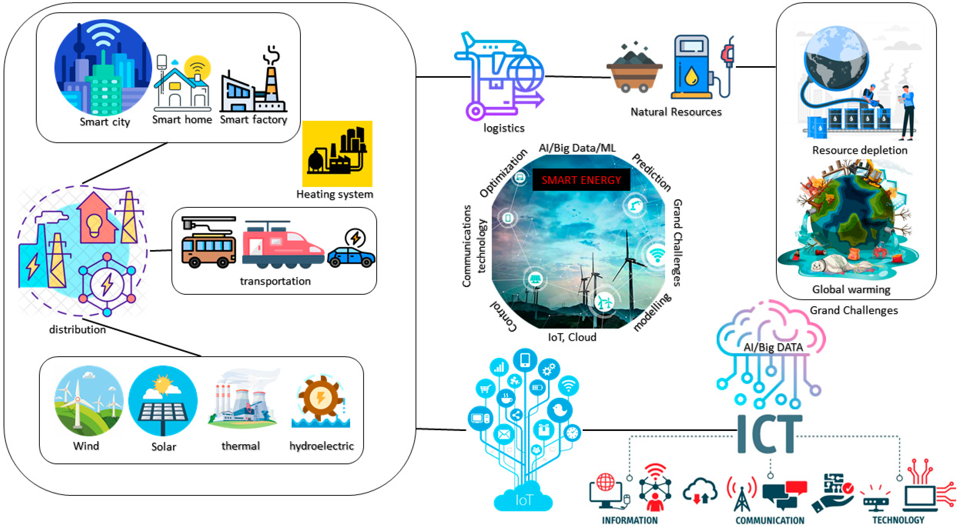
04
  Technology Integration
Notes:
Examples:
Example 1: AI-Powered Smart Grids in Bengaluru:
Technology Used: Artificial Intelligence (AI)
Description: AI is integrated into smart grids in Bengaluru to optimize electricity distribution. AI systems analyze real-time data from sensors to predict energy demand, adjust supply, and integrate renewable energy sources like solar and wind. This improves grid efficiency, reduces energy wastage, and supports the transition to low-carbon energy systems.
Example 2: IoT-Enabled Smart Metering in Delhi:
Technology Used: Internet of Things (IoT)
Description: In Delhi, IoT-based smart meters are deployed across homes and businesses to track energy consumption in real-time. This allows users to monitor their energy usage, while utilities can optimize energy distribution, reduce peak demand, and minimize emissions by better matching supply and demand. The system also enables prompt detection of energy inefficiencies and leakage.
Example 3: Big Data for Traffic Optimization in Pune:
Technology Used: Big Data
Description: Pune leverages big data analytics to optimize traffic management. The city collects data from traffic sensors, cameras, and GPS systems to monitor traffic flow, predict congestion, and optimize signal timings. This reduces traffic congestion, lowers fuel consumption, and cuts emissions from the transportation sector, contributing to a more sustainable urban mobility system.
Example 4: AI for Predictive Maintenance in Smart Buildings in Gujarat:
Technology Used: Artificial Intelligence (AI) and IoT
Description: In Gujarat International Finance Tec-City (GIFT City), AI and IoT are integrated into smart buildings for predictive maintenance. AI analyzes data from sensors installed in HVAC systems, lighting, and other energy-consuming equipment to predict when maintenance is needed, preventing inefficiencies. This reduces energy consumption, prolongs the lifespan of equipment, and lowers carbon emissions from buildings.
These examples showcase how AI, IoT, and Big Data technologies are effectively being integrated into India's urban infrastructure to promote energy efficiency, reduce carbon emissions, and support the transition to a low-carbon future, hence placing Technology integration as a key strategy.

Slide 27




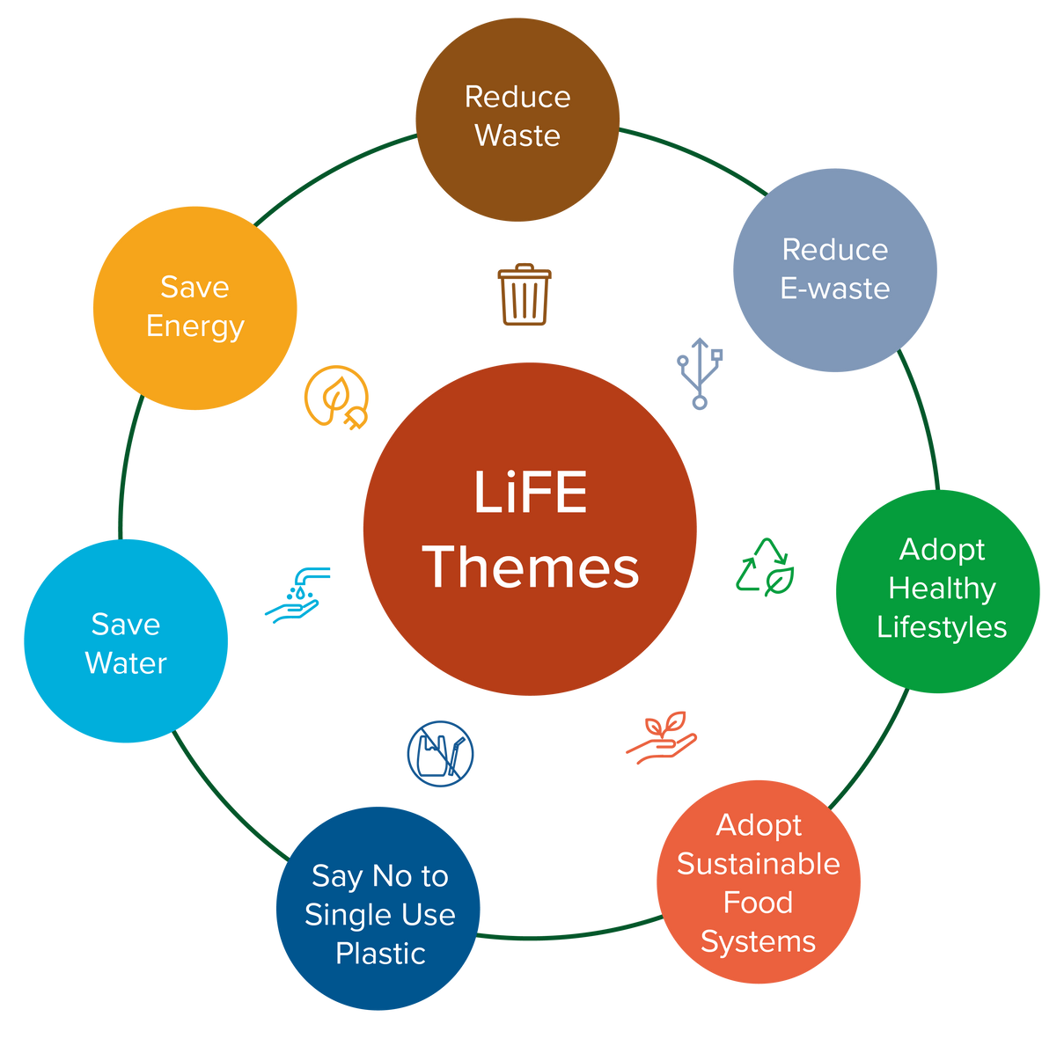





05
  Capacity Building and
Skill Development
06
  Stakeholder Engagement
and Public Awareness
Training Programmes
Curricula Integration in Academia
Awareness
Green Job Transition
Knowledge Sharing Forums
Community Engagement
Conscious Lifestyle Choices
Upskilling Government Officials
Industry Exposure
Notes:
05 - Capacity Building and Skill Development:
Training Programs: Training Programmes targeting Sustainable Infrastructure Development Courses and implementing specialized training for professionals in renewable energy, energy-efficient technologies, sustainable construction, green urban planning, etc.
Curriculum Integration: Introducing low-carbon infrastructure topics into educational curricula at universities and technical institutes to equip future generations with the necessary skills.
Workforce Transition Support: Providing support to workers in carbon-intensive industries to transition to jobs in low-carbon sectors through re-training and re-skilling initiatives.
Knowledge Sharing: Facilitating access to global knowledge, best practices, and innovative technologies through workshops, conferences, and international partnerships.
Capacity Development for Local Governments: Training local government officials in sustainable urban planning, climate-resilient infrastructure, and green policy implementation to enable effective governance.
Industry Collaboration: Partnering with industries to develop sector-specific skillsets, ensuring that professionals are aligned with the latest advancements in low-carbon technologies.
06 - Stakeholder Engagement and Public Awareness
Community Engagement:
Engaging local communities in the decision-making process for low-carbon infrastructure projects through public consultations and forums.
Providing training and resources to local communities to actively participate in the development and maintenance of sustainable infrastructure projects.
Promoting open dialogue and transparent decision-making to build trust and ensure that projects meet the needs of diverse communities.
Establishing channels for continuous feedback from stakeholders to adapt and improve low-carbon infrastructure projects based on community needs and preferences.
Offering incentives such as tax breaks or subsidies to businesses and communities that adopt or support low-carbon practices.
Awareness Campaigns:
Launching awareness campaigns to inform the public about the impacts, hazards of climate change and benefits of low-carbon infrastructure.
Utilizing digital platforms to spread information, engage younger generations, and encourage widespread participation in sustainability efforts.
Conscious Lifestyle Choices: Encourage Conscious Choices. A significant example of this is India’s Mission LiFE that promotes bringing a change in behavioural choices is a Pro-Planet-People movement.

Slide 28
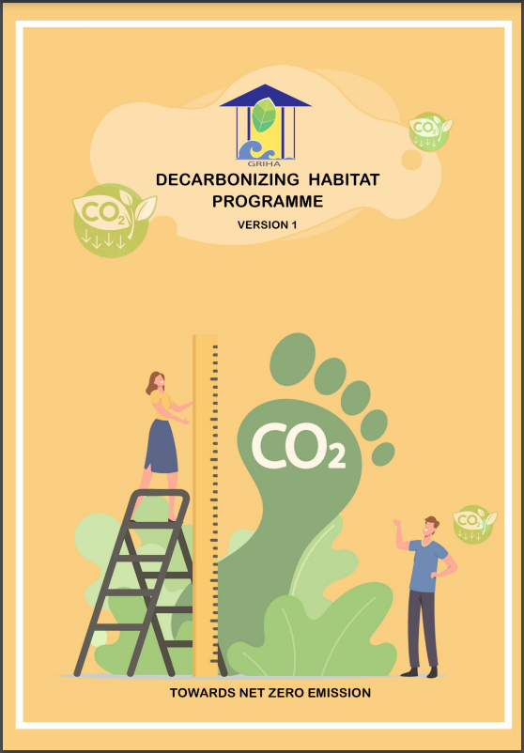
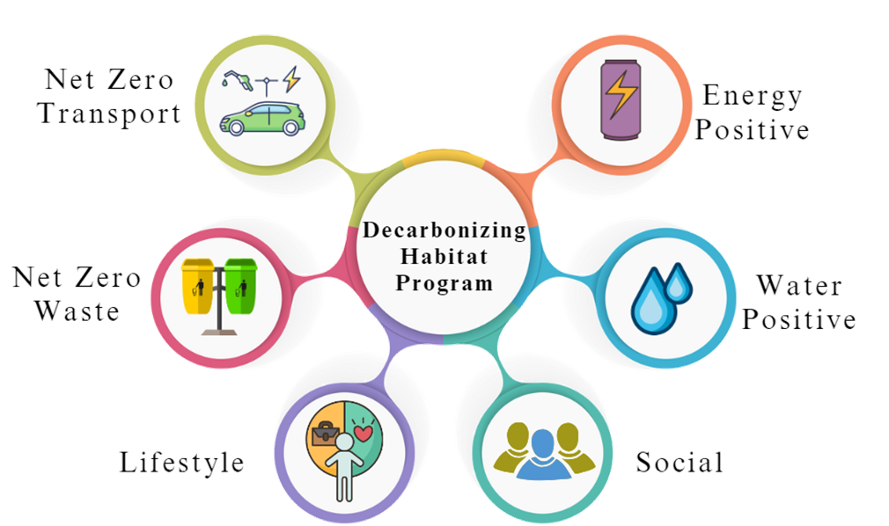
GRIHA
Decarbonizing Habitat Programme (DHP)
Quantitive
Qualitative
Source:https://www.grihaindia.org/sites/default/files/pdf/Manuals/R6_DHP_Manual.pdf
Notes:
In commitment to the vision of our achieving Carbon Neutrality by 2070, GRIHA Council has initiated a drive towards a zero-carbon mission, under which it has launched the Decarbonizing Habitat Program (DHP). This program would enable an organization/ company/ industry to estimate its current carbon footprint and adopt cost effective strategies that will help in reducing the footprint in the future. It will assess the holistic environmental performance of a building throughout its lifecycle. The certification analyses carbon emissions from transportation, energy, water and fuel consumption; and waste generation in a building.
Net Zero Emissions of a project will be based on Reduction in Carbon Emissions + Carbon Sequestration.
The Certification targets the 6 components:
Transport
Energy
Water
Waste
Social
Lifestyle
Transport and Waste aim to push project towards net zero emissions
Water and Energy towards Net Positive
These 4 components are quantitative.
The other two components of Social and Lifestyle will be analysed; however, are qualitative indicators.

Slide 29
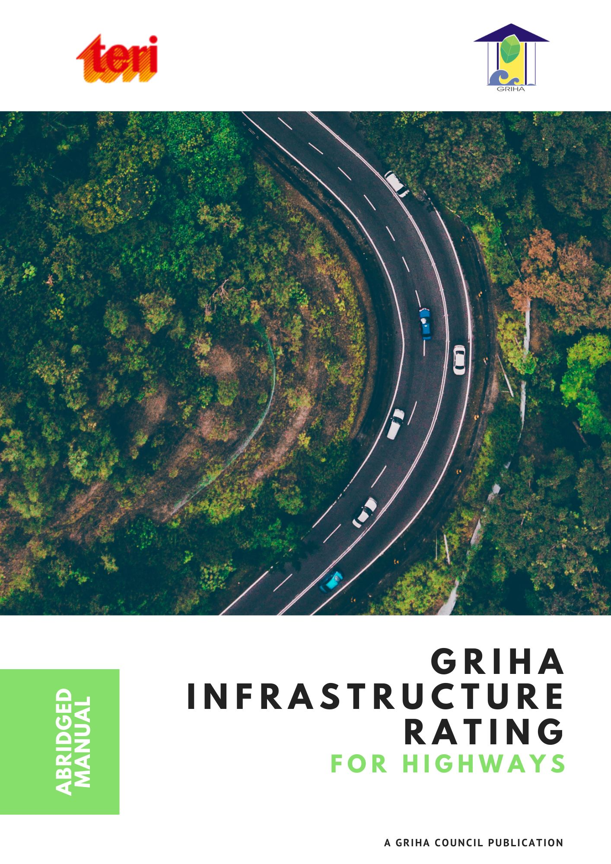
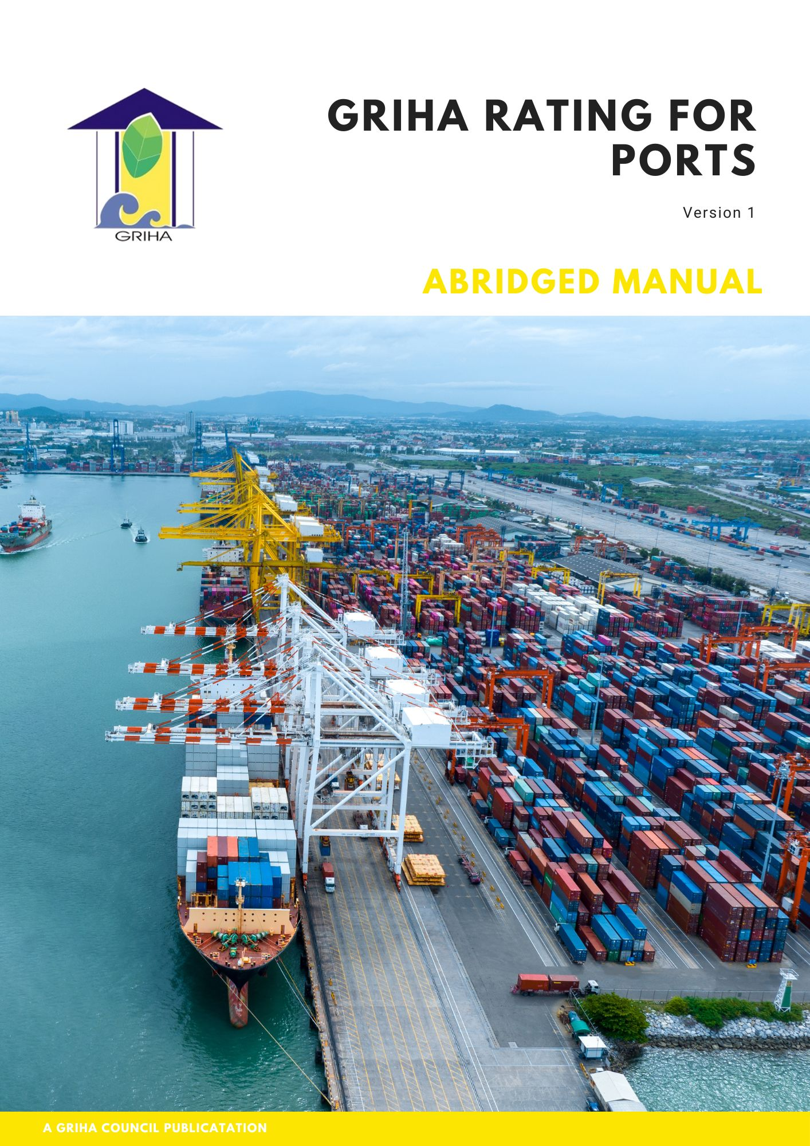
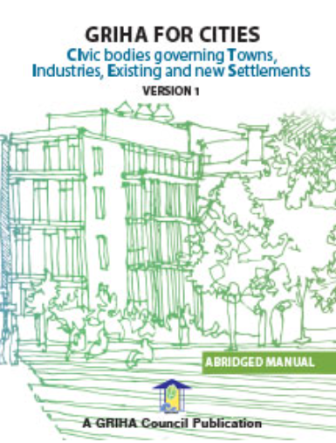
GRIHA
Ratings for Assessment
Notes:
GRIHA has multiple rating variants, catering to the various applicability needs as per projects’ scale, whether it is a new construction or existing construction. The following rating variants are targeted specifically at addressing infrastructure requirements.
GRIHA Infrastructure Rating for Highways
GRIHA Rating for Ports
GRIHA for CITIES
GRIHA Infrastructure Rating for Highways: To promote responsible infrastructure development, GRIHA Council has introduced the GRIHA Infrastructure Rating for Highways. This rating system aims to provide a structured framework that evaluates the sustainability aspects of highway projects, encouraging environmentally responsible practices, resource efficiency, and long-term resilience. This rating has been designed to address these critical needs by promoting sustainable practices throughout the project lifecycle—from planning and design to construction, operation, and maintenance.
GRIHA Rating for Ports: The nation is geared up to achieve the Net Zero emissions target by 2070 set by the Hon’ble Prime Minister of India at COP26. As we proudly aim high, it is important for all sectors to come together and contribute towards the achievement of the national goal. With this intent, GRIHA Council has formulated guidelines for Green Ports in India while recognizing the pivotal role of Indian maritime sector in laying the foundation of net zero economy. The GRIHA Rating for Ports intends to ensure the development of sustainable and resilient ports - both with varying evaluation parameters and process for new and existing projects.
GRIHA for CITIES: CITIES – An acronym for CIvic bodies governing Towns, Industries, Existing and new Settlements - GRIHA for CITIES rating has been structured as a framework for sustainable development of a city, to be achieved by measuring 'greenness' of existing as well as proposed cities. Qualitative and quantitative criteria have been integrated into the rating to cover diverse aspects of sustainable development. The rating sets performance benchmarks for key resources such as energy, water and waste; and evaluates the project's performance in areas such as smart governance, social wellbeing, and transportation. The rating is in synchronization with the work being done to achieve targets of Sustainable Development Goals, UNFCCC. Furthermore, specifically the work being done in the country through MoHUA's Livability Index, Ease of Living Index and smart cities initiatives. It covers sections of Smart Governance, Water Supply and Management, Sanitation and Municipal Solid Waste Management, Sustainable Mobility, Energy Optimization and Management and Quality of Life.

