Slide 1
Employee evaluation and attestation

Slide 2
Employee Assessment - A targeted process to determine the alignment of employees' qualitative characteristics with job or workplace requirements.

Slide 3
Employee evaluation can be conducted in two directions:
− Evaluating labor results within a specified time period;
− Assessment of the employee's competence and the effectiveness of their work behavior.

Slide 4
The evaluation of employee performance fulfills a number of tasks and is aimed at achieving three main objectives:
The administrative goal is achieved through making a well-founded administrative (personnel) decision based on the results of evaluating employee performance. Such decisions may include promotion or demotion, transfer to another position, referral for training, or dismissal from work.
01
The purpose of information is to obtain objective and reliable data about work, enabling employees and managers to improve performance and make correct decisions..
02
03
Motivational assessment is inherently the most important means of motivating people's behavior.

Slide 5
Natural and biological
Social-psychological
01
04
Socioe-conomic
Market
02
05
Factors affecting employee assessment
Technical-organizational
03

Slide 6
Group of factors | Structural elements
Natural biological | Age. Health condition. Mental abilities. Physical capabilities. Climate. Geographic environment. Seasonality & others.
Socioe-conomic | The state of the economy. Government requirements, restrictions, and laws in the field of labor and wages. Employee qualifications. Work motivation. Standard of living. Level of social protection and other factors.
Technical-organizational | Nature of tasks to be addressed. Complexity of labor. State of production and labor organization. Working conditions (sanitary-hygienic, aesthetic, ergonomic, and others). Volume and quality of information obtained. Level of utilization of scientific and technological achievements, and other factors.
Social-psychological | Attitude towards work. The employee's psychophysiological state. Moral environment in the team and other factors.
Market | Development of a multi-sector economy. Growth of entrepreneurship. Extent and scale of privatization. Competition. Independent selection of wage systems. Liberalization of prices. Conversion of enterprises into joint-stock companies. Inflation. Bankruptcy. Unemployment and other factors.

Slide 7

Based on the objectives of employee evaluation, the following tasks can be addressed:
−assessment of employee promotion opportunities and reduction of the risk of promotion of incapable persons;
− Setting training expenses;
− Supporting workforce motivation;
−Establishing a system for feedback on work quality;
−Developing employee training programs.
Tasks for employee evaluation

Slide 8
Personnel information consists of a comprehensive set of operational data and the processes for processing this data for personnel planning purposes. It must meet the following requirements:
simplicity
unambiguousness
consistency;
The information should contain only the necessary amount and quantity of data.;
The information should not be ambiguous.
When interpreting it, it is necessary to pay attention to the semantic, syntactic, and logical unambiguity of the material;
Information about personnel provided for different time periods must have consistent calculation methods and presentation formats.;
visibility
comparability
relevance
Information should be presented in such a way that
the main points can be quickly identified and unnecessary words can be avoided. To achieve this, it is necessary to use tables, graphs, and color design of the material.;
The data should be presented in comparable units and pertain to comparable objects both within the organization and externally;
The information should be new, prompt, and timely, that is, provided without delay..

Slide 9
Xodimlar mehnat natijalarini baholash tizimi
Personalni baholash - bu turli elementlar: subyektlar, obyekt, predmet, mezonlar, usullar yig‘indisidir.

Slide 10
Employee Performance Evaluation System
Content of assessment (personal qualities, work process, work efficiency);
Bizyukova's approach is the most popular, according to which the assessment structure.
assessment methods;
baholash tartibi (baholash subyekti, baholash joyi, baholash davriyligi, baholash ketma-ketligi)

Slide 11
Employee Assessment
Employee Assessment | Elements of evaluating work performance
Subject | Line leaders. Personnel Management Service Employees. Staff. Independent Experts.
Object | Employees. Employee Groups.
Assessment subject | Personal qualities of employees. Work process. Labor productivity.
Assessment methods | Management by objectives. Graphic rating scale method. Internal selection. Descriptive method. Critical incident evaluation method. Questionnaire and comparative questionnaire method. Behaviorally anchored rating scale (BARS) method. Behavioral observation scale method.
Assessment process | Assessment location. Assessment frequency. Assessment sequence.

Slide 12

Evaluation subjects are categorized into formal and informal types..
Official subjects- include managers and employees of the personnel management service.
Informal actors- colleagues and independent experts - provide conclusions that are taken into consideration by official entities when making management decisions..

Slide 13
Employee assessment criteria
By establishing clear and well-thought-out criteria for employee evaluation, it is possible to obtain an objective assessment. The criteria to be established can be highly diverse, but they should always be directly related to the subject of assessment and be goal-oriented.

Slide 14
Four groups of criteria can be distinguished that are applicable in any organization:
1. Professional criteria include characteristics of professional knowledge, professional experience, skills, competencies, qualification levels, and labor outcomes;
2. Criteria for entrepreneurship: responsibility, organizational skills, initiative, and industriousness;
3. Moral and psychological criteria - mental stability, self-assessment ability, honesty and fairness;
4. Specific criteria are formed based on qualities inherent to a person and characterize their health status, reputation, and personal characteristics..

Slide 15

The results of managers' work are determined based on the outcomes of production, economic, and other activities of the organization or its structural subdivisions..
The results of specialists' work are determined based on the volume, completeness, quality, and timeliness of fulfilling their assigned official responsibi-lities.

Slide 16

Two groups of indicators are used to evaluate labor efficiency. :
Direct (or quantitative) indicators are easily measurable, can be objectively quantified, and are predetermined; based on these indicators, the degree of achievement of the set goals is determined;
Indirect indicators, which indirectly influence the achievement of results; it is impossible to determine them quantitatively.

Slide 17

Two groups of criteria are used to evaluate employee productivity: "hard" and "soft" indicators.
PowerPoint
"Hard" indicators are easily measured, can be objectively quantified to a sufficient degree, and are always predetermined.
"Soft" indicators are distinguished by their certain dependence on the evaluator's subjective opinion, as they cannot be quantitatively determined..

Slide 18
Assessment Stages:
1) describing tasks;
2) identifying requirements;
3) evaluating based on factors of a specific performer;
4) calculating the overall assessment;
5) comparing with the standard;
6) assessing the employee's level;
7) communicating assessment results to the employee.
The direct supervisor is primarily responsible for employee evaluation. They are accountable for ensuring the objectivity and completeness of the information base necessary for current periodic assessments and conduct evaluation interviews with employees. In the hiring process, the main task of the HR department evaluating candidates is to select an employee who can achieve the results expected by the organization. In essence, evaluation during hiring is one of the forms of initial quality control for the organization's human resources.

Slide 19


Despite the existence of numerous different approaches to assessment, they all share a common shortcoming.- from subjectivity suffers. The decision largely depends on the person applying the method or on the individual they engage as an expert

Slide 20
−impartiality - being independent from personal opinions or individual considerations;
−Relative independence from the influence of situational factors (mood, weather, past achievements and failures);
− Reliability - the level of a person's skill acquisition and how effectively they perform their duties should be assessed.;
−Predictive capability - the assessment should provide information about the types of activities in which a person has potential abilities and to what extent these abilities are present.;
−Complexity - not only is each member of the organization evaluated, but also the connections and relationships within the organization, as well as the capabilities of the organization as a whole are assessed.;
− Clarity - The assessment process and criteria should be comprehensible to evaluators, observers, and those being evaluated, meaning they should possess the quality of internal precision;
− Clarity - the assessment process and assessment criteria should be understandable for evaluators, observers, and those being evaluated, that is, they should possess the quality of internal precision.;
Kadrlar ishining umumiy tizimiga shunday kiritilganki, u tizimni rivojlantirish va takomillashtirishga amalda yordam beradi.
Requirements for employee evaluation technology:

Slide 21
Methods for Evaluating Employees

Slide 22
Criterion | Types of Techniques | Brief description | Examples
Subject bo‘yicha | Individual | The evaluation will be conducted by a single manager or expert | Individual interviews and test assignments
 | Group-based | The assessment is conducted collaboratively by multiple evaluators | Certification Commission and Assessment Center
 | Self-assessment | The employee evaluates their own performance independently. | Self-Assessment Questionnaire and Reflective Report
According to the subject | Personal traits | The employee's personal qualities and conduct are evaluated. | Psychological tests and character assessments
 | Labor process | An analysis is being conducted on how the work is being performed | Behavior observation scale
 | Labor outcomes | Work outcomes and efficiency are measured | KPI and goal-based evaluation
According to the form of presen-tation | Oral (spoken) | Assessment is expressed through words | Description, verbal explanation
 | Formalized (graphic or symbolic) | It is measured by score, rating, and scale | Graphical Rating Scale Method
 | Combined | It is measured by scores, ratings, and scales | Assessment scorecard and comments
Classification of employee evaluation methods

Slide 23

Classification by Purpose and Object
Criteria | Types of methods | Brief description | Examples
Accor ding to purpose | Forecast | Assesses the employee's potential and prospects | Competency-Based Interview, Assessment Center
 | Practical | Identifies the current work outcomes | KPI Analysis and Management by Objectives (АMO)
Accor ding to the result | Quality (descrip tive) | Based on thoughts and descriptions | Recommendations and questionnaires
 | Quantity (numerical) | Based on figures and statistics | Point system, rankings, and KPIs
 | Combined | It combines both approaches | Scoring and Annotated Assessment Form
Regarding the object | Leaders | Assesses leadership and management competencies | 360-Degree Assessment, Business Simulations
 | Performers | Values discipline, productivity, and precision | Observations, tests, and production indicators

Slide 24
Traditional аssessment мethods
Features:
1. Focused on individual employees
2. Conducted by the manager
3. Takes into account achieved results
4. Does not reflect potential and long-term prospects
Types:
1. Scaling methods (forced choice, descriptive method, graphic rating, observation scale, standard ratings)
2. Comparative methods (ranking, paired comparison, forced distribution, management by objectives)
Advantages: simplicity, affordability, cost-effectiveness
Shortcomings: subjectivity, one-sidedness, failure to consider potential

Slide 25

Additional assessment methods
Expert method - an employee is evaluated by their colleagues or specialists. This method is typically used in stable (peaceful) organizations, as employees know each other well. ..
For example: the most experienced employees in the department jointly evaluate the work of others..
A written character reference (or characteristics assessment) is a written opinion about an employee provided by a manager or the personnel department. It is primarily used during performance evaluations or when considering a change in position.
For example: "The employee is responsible, capable of working in a team, and possesses leadership abilities."
The record-keeping method (method of notes) - throughout the year, the manager keeps records of the employee's successes and mistakes. Afterwards, the overall result is analyzed.
For example: "In March, the project was submitted ahead of schedule, in August there was a problem with the client."

Slide 26

Ranking (comparative assessment) methods
Direct ranking - employees are arranged from the best to the lowest according to a single criterion (for example, discipline or initiative).
For example: 1st place - most disciplined, 5th place - least disciplined.
Alternating selection - first choose the best, then the worst, then the best again, and so on..
For example: "The most creative," then "the least productive," then "the next most creative"...
The paired comparison method - each employee is individually compared with others. The more effective employee receives points.
For example: A and B are compared - A is better, therefore A gains +1 point.

Slide 27

Non-traditional assessment methods
Features:
1. Emphasis on employee potential
2. Assessment by colleagues and experts
Examples:
1. Analysis of specific situations
2. Programmed assessment
3. Business and role-playing games
4. Expert evaluations
5. Psychological tests, interviews, exercises
Shortcomings:
1. Conflicts within the team
2. Difficulty in interpreting potential

Slide 28

Methods for Assessing Potential
Employee Assessment Centers (Assessment Centers)
Professional aptitude tests
General Aptitude Tests
Biographical tests
Psychological Self-Assessment Tests
Conversation
Descriptions
Non-traditional methods (polygraph, stress tests, handwriting analysis, and others)

Slide 29
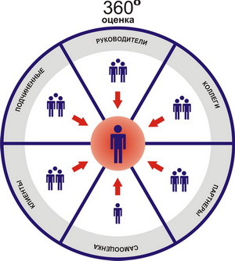
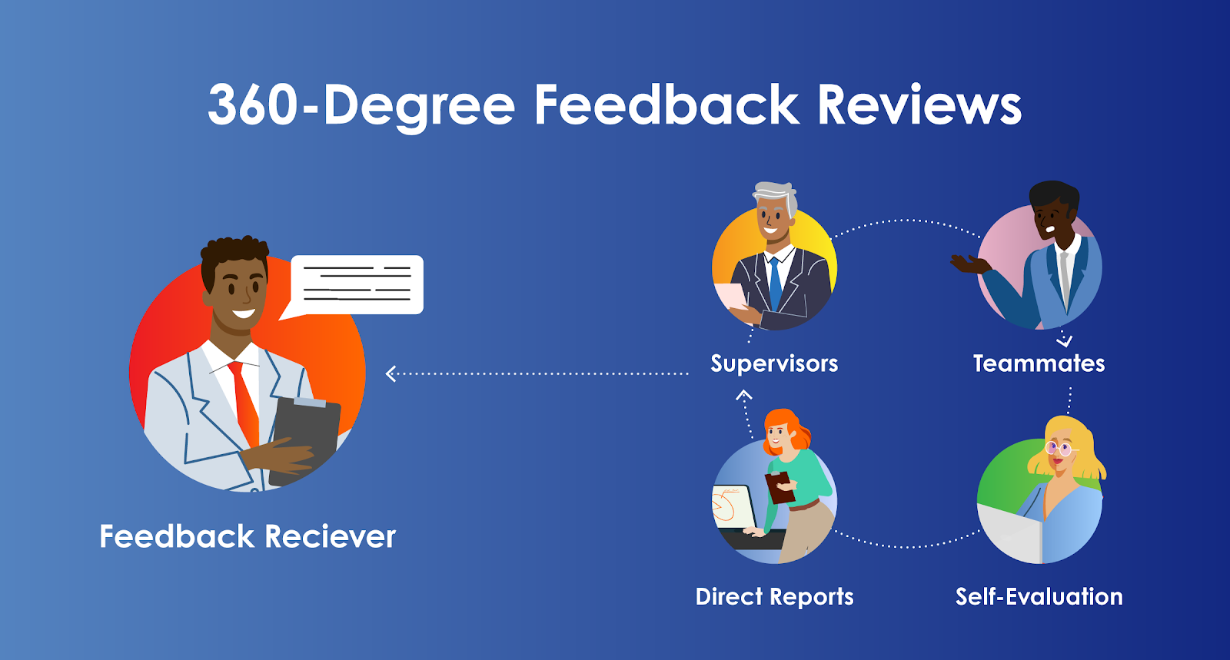

Slide 30
Employee Assessment Centers
Assessment Center - a department for comprehensive evaluation and development of employees.
Key areas of operation :
Identifying needs and formulating inquiries.
Developing assessment technologies and methods.
Safeguarding participants (evaluators, clients, employees).
Objective: Enhancing assessment quality, predicting employee potential, and fostering their development.

Slide 31
Psychological effects
during the assessment process
The human factor plays a crucial role in assessment. Personal impressions of a manager or expert can sometimes compromise objectivity. Therefore, it is necessary to be aware of and take into account the following effects:

Slide 32
ATTESTATION
It is a system for assessing the level of specific knowledge and skills necessary for employees to effectively perform their official duties. This is a form of employee evaluation; however, it is inappropriate to contrast these two concepts or replace one with the other. The main purpose of attestation is to verify the employee's knowledge in the professional field and determine to what extent they are suitable for the position they hold..

Slide 33
There are four types of employee attestation. :
The next mandatory evaluation is to be conducted at least once every two years for managers, and once every three years for specialists and other employees..
Upon completion of the probationary period - It is conducted based on the results of adaptation to the new workplace, with the aim of developing substantiated recommendations for the utilization of the person undergoing attestation..

Slide 34

There are four types of employee attestation:
3. In terms of professional advancement - It is conducted to determine the employee's potential capabilities and level of professional training, taking into account the requirements of the new job position..
4. When transferred to another department - The job responsibilities and requirements imposed by the new position will change significantly. The certification process is conducted in all departments of the organization. The list of positions subject to certification and the timeframes for conducting it are determined by the head of the organization.

Slide 35
Grading scale - this is the most commonly used method of performance evaluation. It is based on a list of personal characteristics or factors, each of which is accompanied by a scale, typically consisting of five points. On this scale, the manager (supervisor) determines to what extent a particular factor or trait is characteristic of the employee..
Open certification - The method represents an innovation introduced due to the inadequacy of the traditional evaluation scale scheme.
Instead of forcing managers to assess a number of personal characteristics that are not always relevant to the certification process, the new method focuses attention on the nature of work performance. In this approach, rather than marking columns, the manager is required to provide only a few statements about the employee undergoing certification.

Slide 36

Employers are faced with a question: should they hire professional managers or former businessmen?

Slide 37
THANK YOU

