Slide 1
Environmental Requirements for Cities
Prepared by: Kenjayev Aziz Abitqulovich
Department of Ecology and Geography
Gulistan State University
Subject: Urban and Industrial Ecology
Year: 2025

Slide 2
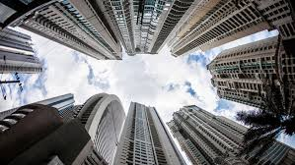
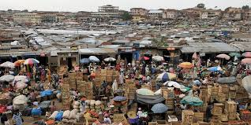
Introduction
Urbanization is rapidly increasing — by 2050, about 68% of the world’s population will live in cities.
Cities are economic centers but also major sources of environmental pressure.
Goal: to create sustainable, environmentally safe, and livable urban environments.

Slide 3
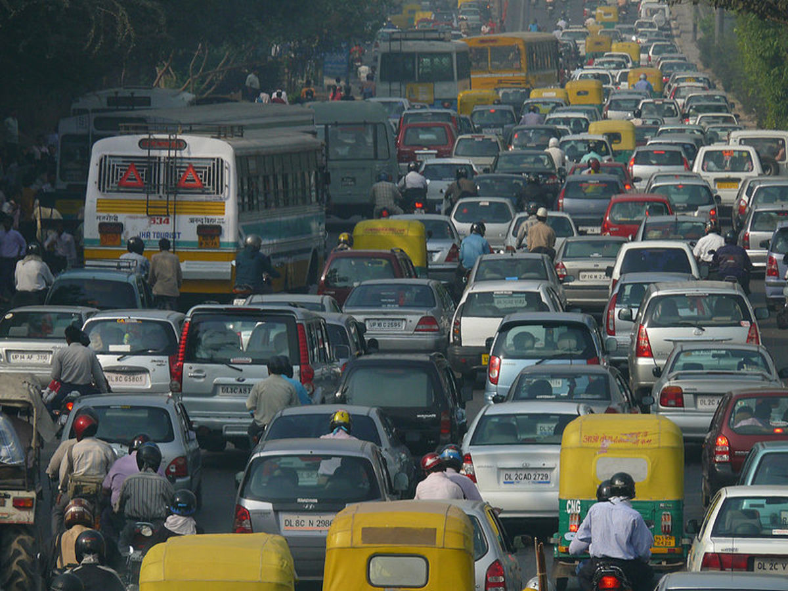
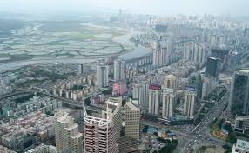
Key Urban Environmental Issues
Air pollution (industrial emissions, vehicles, dust).
Noise and electromagnetic pollution.
Water supply and wastewater management problems.
Solid waste management challenges.
Reduction of green zones and urban heat island effect.

Slide 4
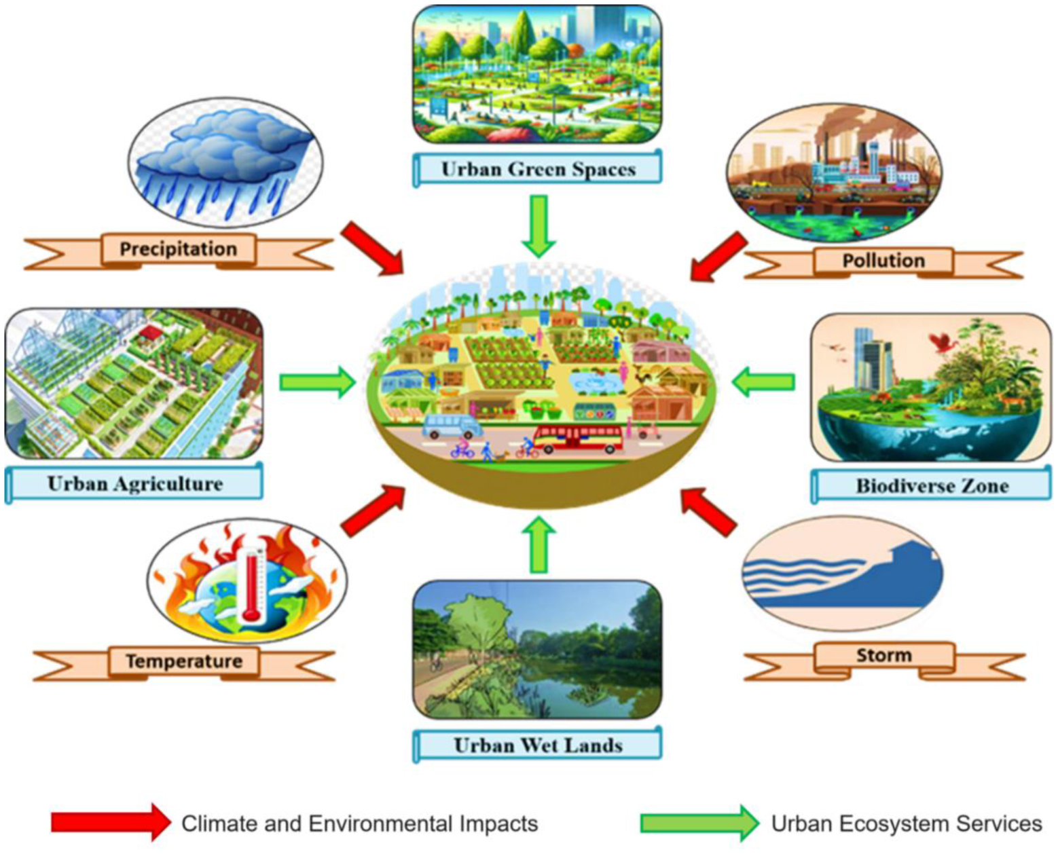
Key Urban Environmental Issues

Slide 5
Concept of Environmental Requirements
Air quality: compliance with PM2.5, NO₂, CO, SO₂, and O₃ limits.
Water resources: wastewater treatment systems in operation.
Waste management: recycling, sorting, and utilization.
Green infrastructure: at least 9–15 m² of green space per capita.
Transport: eco-friendly public transport and bicycle lanes.
Noise control: below 55 dB (day) and 45 dB (night).

Slide 6
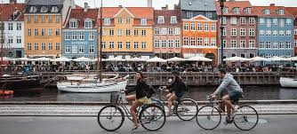

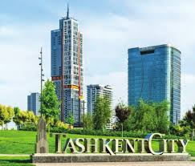
International Experience
Copenhagen – Green transport and zero-waste policy.
Tokyo – 100% waste sorting and recycling system.
Singapore – Smart environmental monitoring system.
Tashkent – 'Green Space' national program (2023–2030).

Slide 7
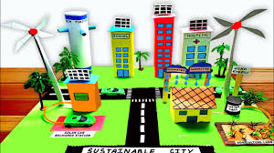
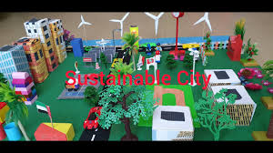
Sustainable City Model
Energy-efficient infrastructure.
Healthy and safe living environment.
Smart governance and digital monitoring.
Ecological transport and mobility.
Citizen participation in environmental actions.

Slide 8
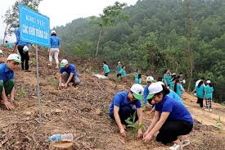
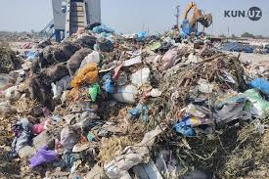

Implementation in Uzbekistan
‘Green Space’ initiative: planting one billion trees.
‘Eco-transport’ policy: introduction of electric buses and bikes.
Waste sorting projects in Tashkent, Samarkand, and Bukhara.
Digital environmental monitoring systems under development.

Slide 9
Conclusions and Recommendations
Environmental requirements are the foundation of sustainable urbanization.
Technology, governance, and public responsibility must align.
Every city should be managed as a living ecosystem.
Recommendations:
1. Establish environmental certification for cities.
2. Create local monitoring centers.
3. Enforce green architecture in new constructions.

Slide 10
References
Law of the Republic of Uzbekistan 'On Environmental Protection', 2021.
UN Sustainable Development Goal 11: Sustainable Cities and Communities.
OECD Urban Green Growth Studies.
Karimov A., 'Urban Ecology', Tashkent, 2023.
www.unhabitat.org | www.stat.uz | www.meteo.uz

