Slide 1

The Necessity, Principles, and Instruments of Transition
to a Green Economy
PhD. Eshkulova Khilola

Slide 2

Contents (Outline)::
1.The limited nature of resources and the necessity of transition to a green Economy
2.Principles of transition to a green economy
3.Political instruments for transition to a green Economy
4.Development of information resources and human capital within the green economy

Slide 3
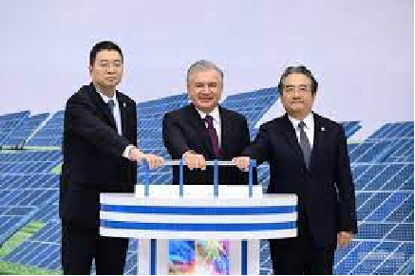
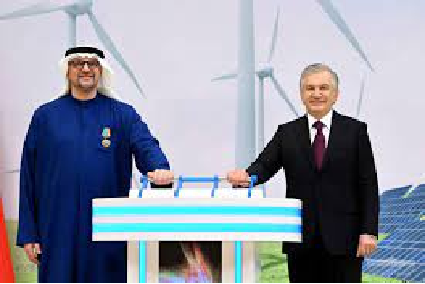
Prospects
The development of renewable energy and green hydrogen in Uzbekistan opens up broad prospects for ensuring energy independence, economic diversification, and environmental sustainability.
By 2030, the implementation of large-scale solar and wind power projects is expected to significantly reduce carbon emissions, create new jobs, and attract foreign investment.
In the long term, the integration of “green” technologies into industry and agriculture will strengthen the country’s competitiveness, promote innovative growth, and contribute to regional energy security.

Slide 4
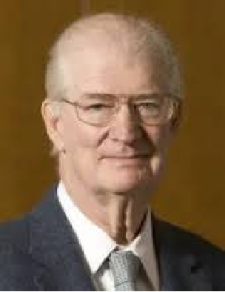
Herman Edward Daly
Herman Edward Daly (1938–2022) — an ecological economist and Professor at the University of Maryland, renowned for his contributions to the concept of a steady-state economy and for integrating ecological sustainability into economic theory and policy.
The economy is interconnected with nature and cannot be separated from it…
Herman Edward Daly “Steady-state economy” second edition with new essays, Island press, Washington, D.C, Covelo, California 1991-year

Slide 5
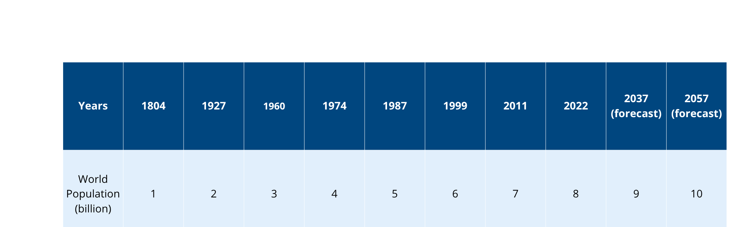
Table 1. Global Population Growth

Slide 6

Fossil fuels
In the past forty years, more fossil fuels have been extracted than during the entire previous history of humankind.
∞<last 40 years

Slide 7

Why is “scarcity” an urgent issue?
  Natural resources (water, fertile soil, and minerals) are being consumed faster than they can regenerate.
  Climate change is degrading resource quality through droughts, salinization, and water shortages.
  The “planetary boundaries” concept warns of the risk of exceeding the Earth’s ecological carrying capacity.
  Rising demand for goods—driven by population growth and urbanization—intensifies pressure on limited resources.

Slide 8
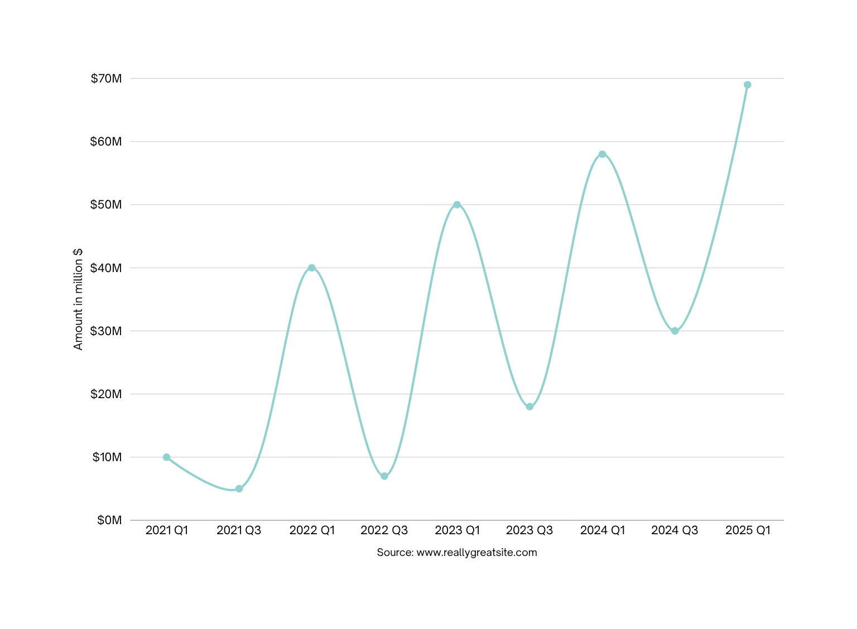
Chart page heading
Economic Consequences
  As resources become scarce, price volatility increases, and production costs rise.
  Growing dependence on raw material imports heightens supply chain risks.
  Natural disasters and crop losses negatively affect GDP, while insurance costs continue to escalate.
Prices

Slide 9
What is a Green Economy? (Definition and Purpose)
Definiton
Purpose
A green economy is one that combines economic growth, low carbon emissions, resource efficiency, and social inclusiveness.
vs
Its main purpose is to enhance human well-being while reducing environmental risks and ensuring the rational use of natural resources.

Slide 10

Why is the Transition Necessary? (Five Strong Arguments)
  Water Efficiency: To maintain agricultural productivity under water scarcity by improving water-use efficiency.
  Energy Security: To reduce dependence on energy imports and vulnerability to fuel price fluctuations.
  Health and Environment: To minimize the hidden costs of air, soil, and water pollution on public health and ecosystems.
  Competitiveness: To gain access to export markets with growing demand for green products and standards.
  Investment Attraction: To mobilize affordable capital through green funds, grants, and bonds that support sustainable projects.

Slide 11
Core Principles of the Green Economy
  Sustainability – ensures balanced progress of economic growth, environmental protection, and social well-being.
  Equity – guarantees equal access to resources and opportunities for all.
  Universal Accessibility – promotes fair and inclusive use of natural and economic resources.
  Healthy Planet – emphasizes the preservation of ecosystems and environmental integrity.
  Participation – ensures active involvement of stakeholders and the public in decision-making processes.
  Good Governance and Transparency – supports efficient resource management, accountability, and openness.
  Adaptability – reflects the ability of the economy to respond to changing environmental and social conditions.
  Efficiency and Sufficiency – focuses on rational, waste-free, and purpose-oriented use of resources.
  Intergenerational Solidarity – maintains a fair balance between the needs of current and future generations.

Slide 12
The principles of transition
The principles of transition to a green economy are aimed at harmonizing economic growth with low carbon development, resource efficiency, and social equity.
The key ideas underlying this transition include:
  Resource Efficiency and “Decoupling” – achieving economic growth with lower consumption of energy, water, and raw materials per unit of GDP.
  Circular Economy and Waste Hierarchy – promoting recycling, reuse, and life-cycle–based decision-making.
  “Polluter Pays” Principle – integrating external environmental costs into prices and ensuring accountability for pollution.
  Precaution and Risk Management – minimizing environmental risks and anticipating potential ecological impacts.
  Just Transition – supporting labor markets and vulnerable groups during the structural shift toward a green economy.
  Innovation and Digitalization – accelerating technological progress and data-driven green solutions.
  Transparency and Environmental Reporting – ensuring open ecological accountability and sustainability disclosure.
  Climate Adaptation and System Resilience – strengthening the ability of economies and ecosystems to withstand climate-related shocks.

Slide 13

https://www.youtube.com/live/G2XU1RvPCok

Slide 14
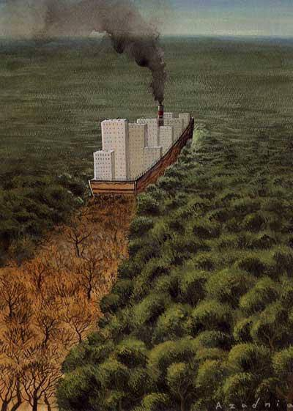



According to research, a single tree produces an average of 120 kilograms of oxygen per year.
An average person requires approximately 600 kilograms of oxygen (O₂) per year, which means it takes about 5–6 trees to supply this amount.
An average person emits around 500 kilograms of carbon dioxide (CO₂) per year, and it takes approximately 30–35 trees to absorb that amount.

Slide 15
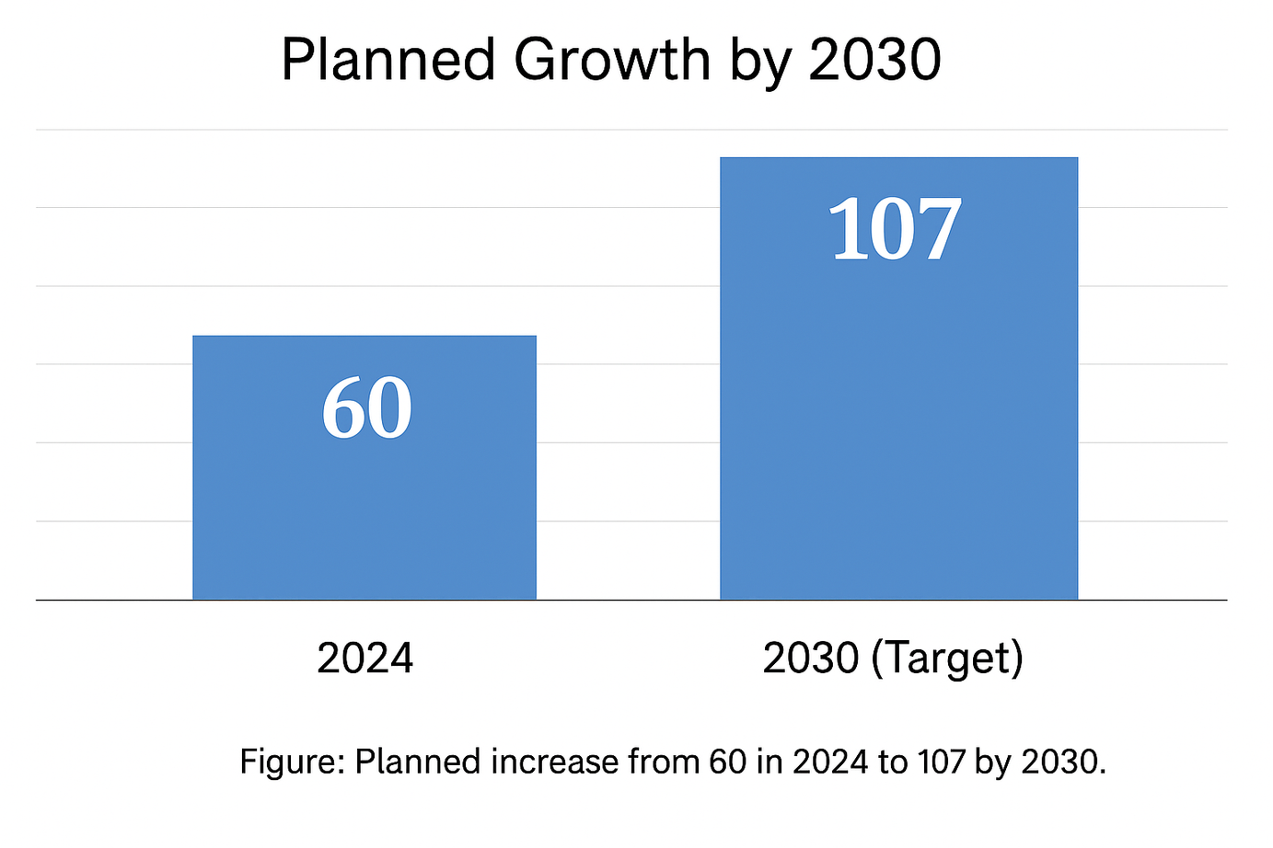
The chart illustrates the planned increase between 2024 and 2030. In 2024, the indicator value is 60, while by 2030 it is expected to reach 107, representing a significant growth of nearly 78% over the six-year period. This projection reflects the country’s commitment to expanding green economic capacity and achieving sustainable development targets by 2030.

Slide 16
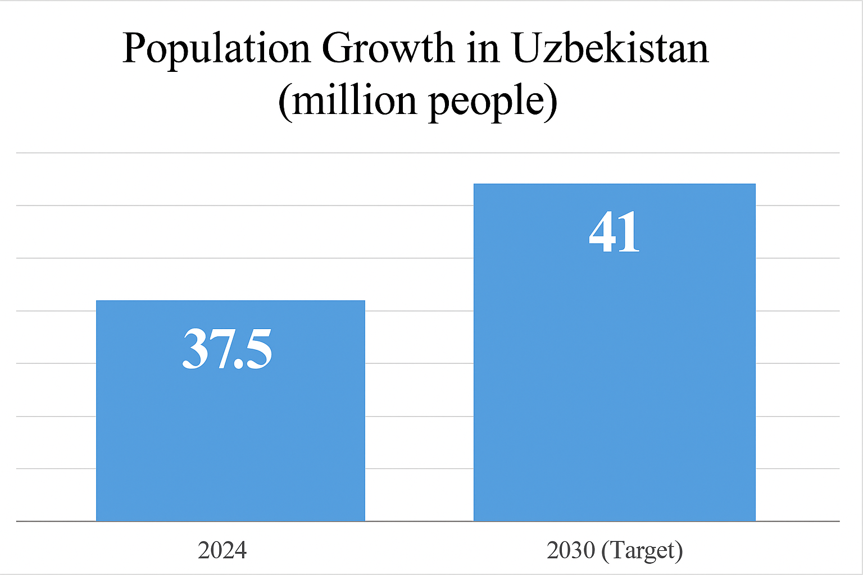
The chart shows the projected population growth in Uzbekistan between 2024 and 2030.
In 2024, the population stands at 37.5 million, and it is expected to reach 41 million by 2030.
This indicates an increase of about 3.5 million people, reflecting steady demographic expansion and continued urbanization trends in the country.

Slide 17
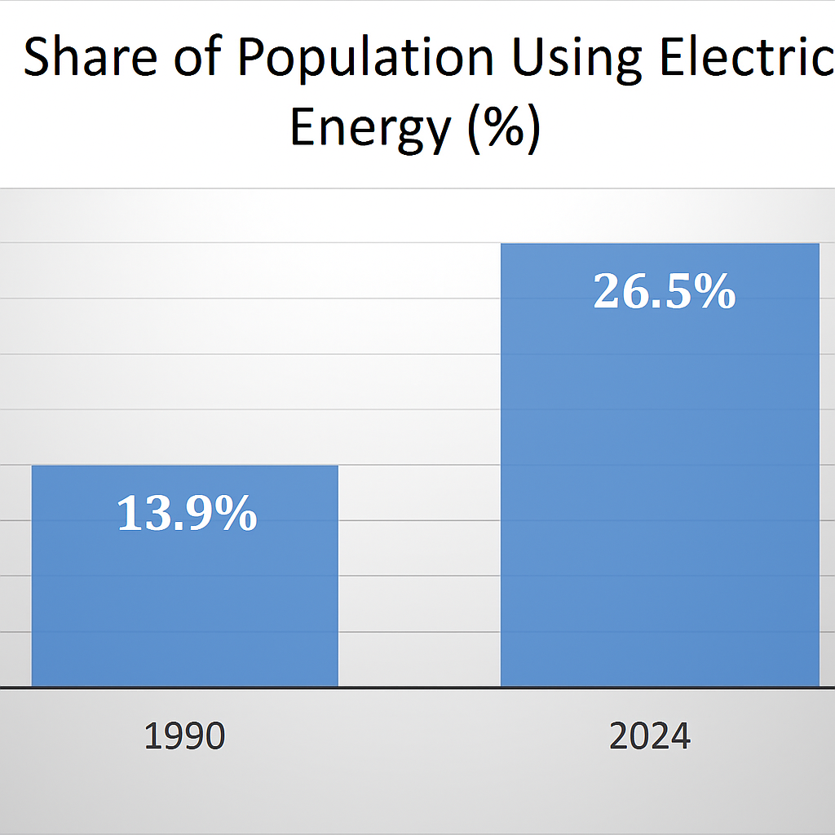
Explanation:
The chart demonstrates the increase in the share of the population using electricity between 1990 and 2024.
In 1990, only 13.9% of the population had access to electric energy, while by 2024, this figure rose to 26.5%, showing a significant improvement in energy accessibility and infrastructure development over the past decades.

Slide 18

“Technological progress is both the cause and the solution of environmental problems.”
Ha-Joon Chang — a South Korean economist and Professor at the University of Cambridge.
(Ha-Joon Chang, “Economics: The User’s Guide”, Tashkent: Butikbook Publishing, 2022, p. 416).

Slide 19
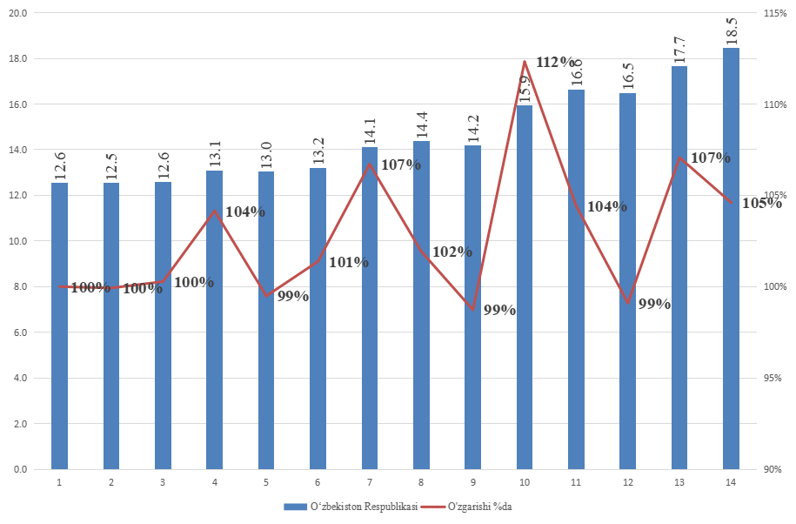
The total installed capacity of power plants in Uzbekistan is approximately 18.312 GW.

Slide 20
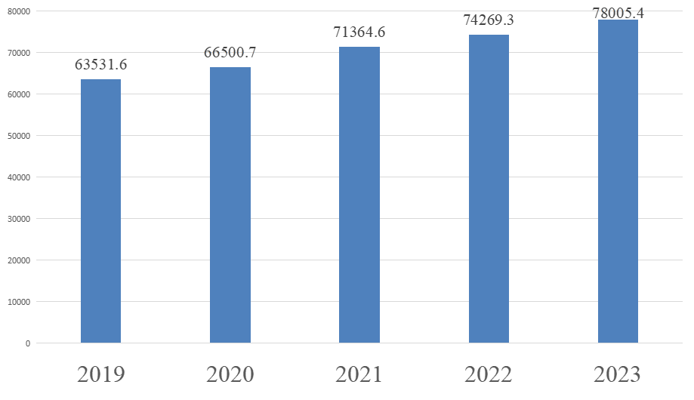
The volume of electricity generation (million kWh).

Slide 21
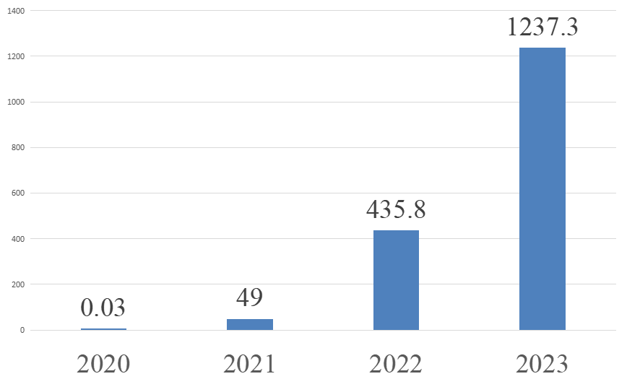
The volume of electricity generated by solar power plants (million kWh).

Slide 22
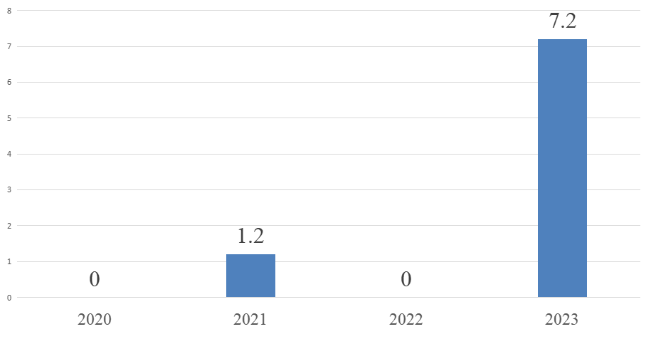
The volume of electricity generated by wind power plants (million kWh).

Slide 23
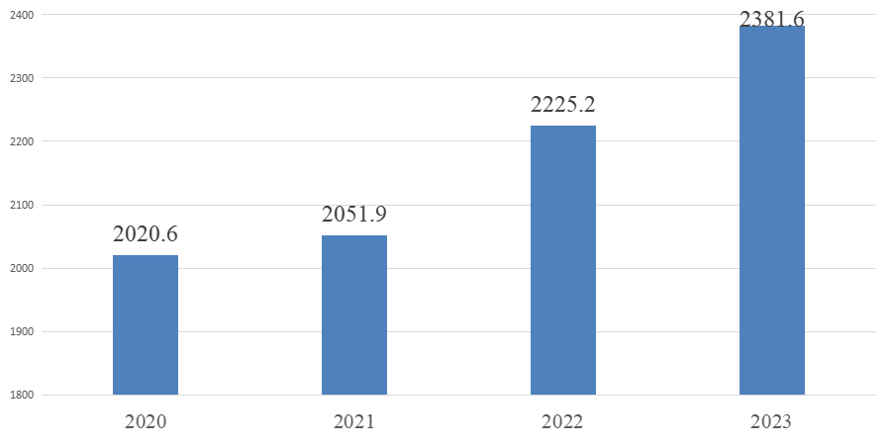
The total installed capacity of hydroelectric power plants (MW).

Slide 24
The development of green energy worldwide is influenced by the following factors:
Growth of price competitiveness through the use of advanced technologies.
Expansion of political initiatives.
Creation of a favorable investment environment.

Slide 25
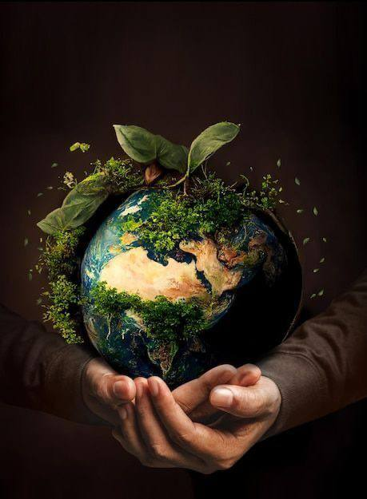
The growing importance of addressing energy and environmental challenges.
The increasing demand for energy.
Ensuring universal access to energy and overcoming energy shortages.

Slide 26

The energy strategy developed by the United Nations Industrial Development Organization (UNIDO) supports the promotion of green energy development. These include:
UNIDO’s Green Energy Strategy Priorities
Enhancing access of low-income populations to modern energy services based on renewable energy sources.
Reducing energy intensity in industry and increasing competitiveness in the energy sector.
Decreasing greenhouse gas emissions in industry to mitigate climate change impacts and promoting the use of renewable and clean energy sources.
Encouraging enterprises in rural areas to utilize renewable and alternative energy sources to ensure long-term operational stability, energy access, and efficiency improvement.

Slide 27
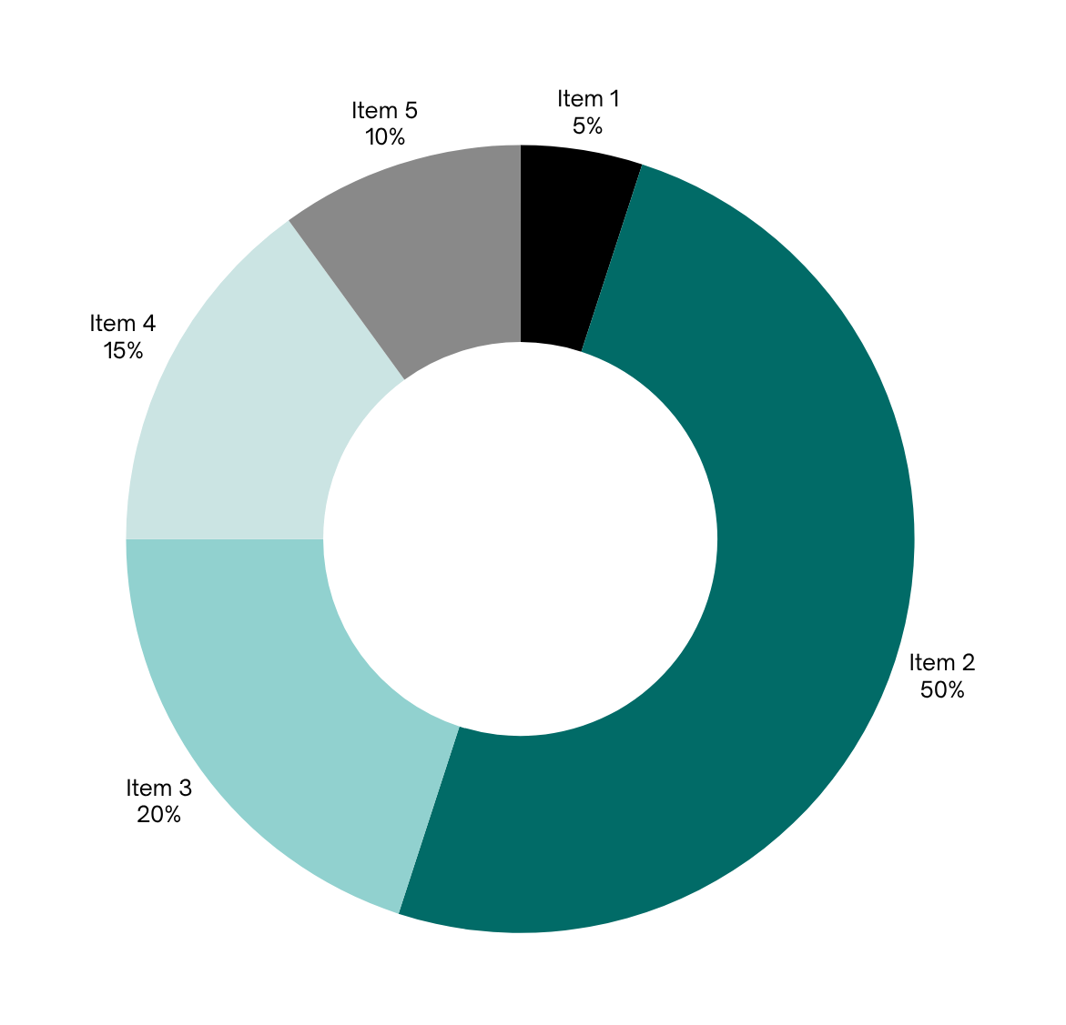
The term “Green Energy” applies to the following technologies:
  Wind Power – wind turbines installed on land and offshore to generate electricity.
  Solar Power – various solar energy technologies used to convert sunlight into electricity.
  Bio Energy – generators operating by burning plant oils, wood, or organic waste materials.
\

Slide 28
(Continuation)
The term “Green Energy” also includes the following technologies:
  Geothermal Power – sources that produce heat and energy from underground hot water or steam flows.
  Hydropower – small hydro turbines installed in rivers with minimal environmental impact.
  Sea Wave Energy – technologies that generate energy by using ocean tides, waves, and water level fluctuations.

Slide 29
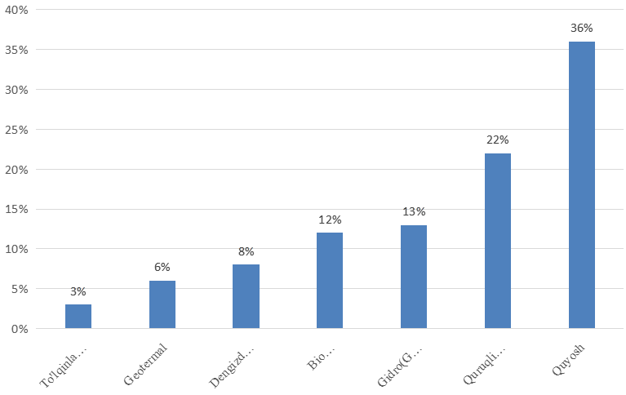
Global Share of Green Energy (2022)

Slide 30
Section 2.
Factors Influencing the Development of Green Energy
In global practice, there are virtually no serious barriers remaining that hinder the active adoption and integration of renewable energy sources.

Slide 31

The following are considered key factors in addressing the existing challenges:
  Achieving network parity in terms of cost
  Economic integration of energy systems
  Development of technological innovations

Slide 32

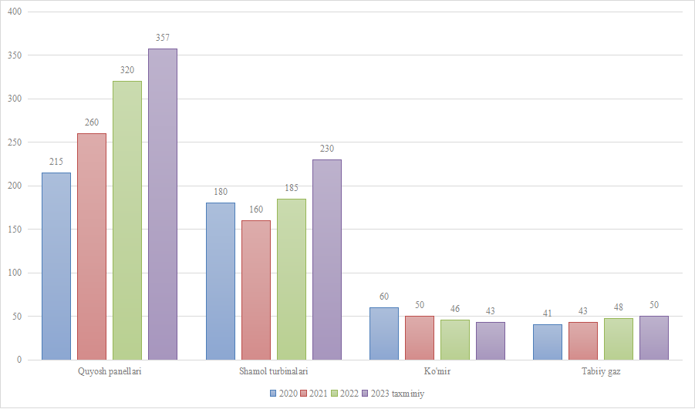
GLOBAL ANNUAL INVESTMENTS IN ENERGY PRODUCTION (Billion USD)
(Based on data from the International Energy Agency, author’s analysis)

Slide 33

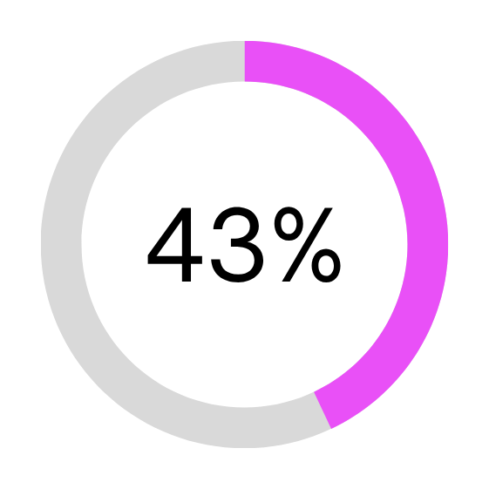
The International Renewable Energy Agency (IRENA) uses the following indicators to assess the efficiency of renewable energy adoption:
Indicators Used by IRENA to Assess Renewable Energy Efficiency
1. Levelized Cost of Electricity (LCOE)
  Represents the total cost of the system — including financing, tax incentives, and depreciation benefits.
  Indicates how much energy the system produces over its lifetime.
2. Capacity Factors
  A measure of the operational efficiency of energy facilities.
  Calculated as the ratio of the actual output of an electric unit over a given period to its potential output if it operated at full capacity continuously.
3. Total Installed Cost (TIC)
  Reflects the total cost of installing energy systems, including the price of equipment, materials, labor, and subcontracting.

Slide 34
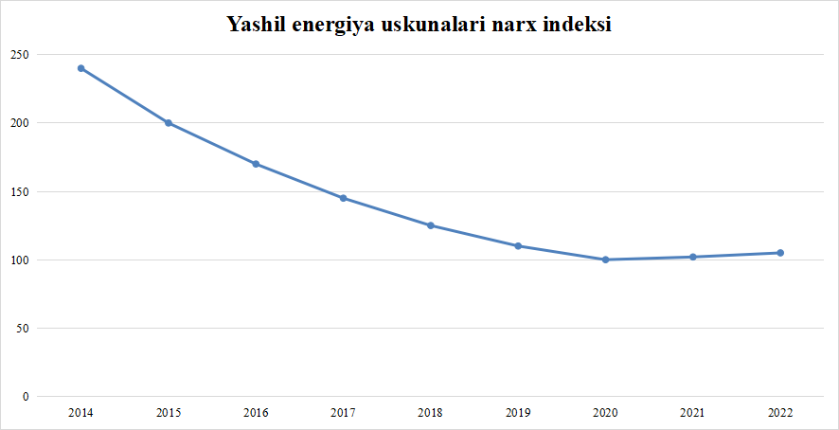
CLEAN ENERGY EQUIPMENT PRICE INDEX (Million USD per Megawatt, Nominal Prices)
(Based on data from the International Energy Agency, author’s analysis)

Slide 35
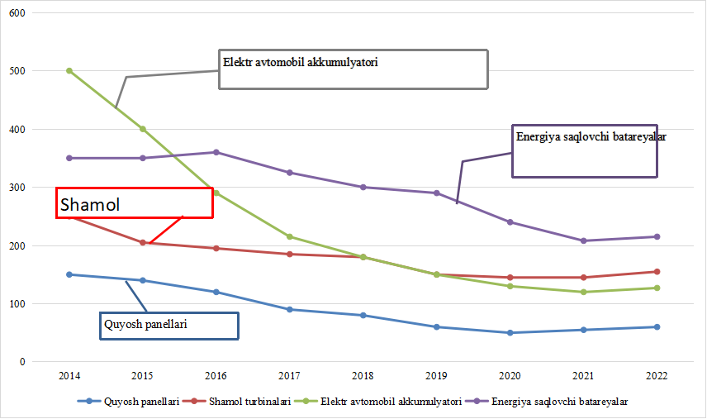
GREEN TECHNOLOGY PRICES (USD per kWh, Nominal Prices)
(Based on data from the International Energy Agency, author’s analysis)

Slide 36

The LCOE (Levelized Cost of Electricity) for wind and solar technologies currently ranges between 30–60 USD per kWh, depending on the type of technology.
This figure is lower even than the cheapest electricity generated from fossil natural gas, which costs 42–78 USD per kWh.
In countries such as China, the United States, Germany, India, Spain, France, Brazil, the United Kingdom, and Canada, the cost of electricity generated by onshore wind turbines has already reached price parity with traditional energy sources.
For large-scale solar power plants, the LCOE stands at around 43–53 USD per kWh.
Similarly, nations including China, Germany, the United States, Italy, India, and the United Kingdom have achieved cost parity with conventional energy sources for these technologies as well.

Slide 37

Key Factors for the Development of Alternative Energy
  Availability of Renewable Resources – ensuring access to solar, wind, hydro, and bioenergy potential.
  Technological Advancement – continuous improvement of renewable energy technologies and efficiency.
  Government Policies and Incentives – implementation of supportive legislation, subsidies, and tax benefits.
  Investment and Financing – attracting domestic and foreign capital through green funds and public–private partnerships.
  Energy Infrastructure Modernization – developing smart grids and energy storage systems.
  Public Awareness and Education – increasing understanding of environmental and economic benefits of clean energy.
  International Cooperation – participation in global renewable energy programs and technology exchange initiatives.

Slide 38

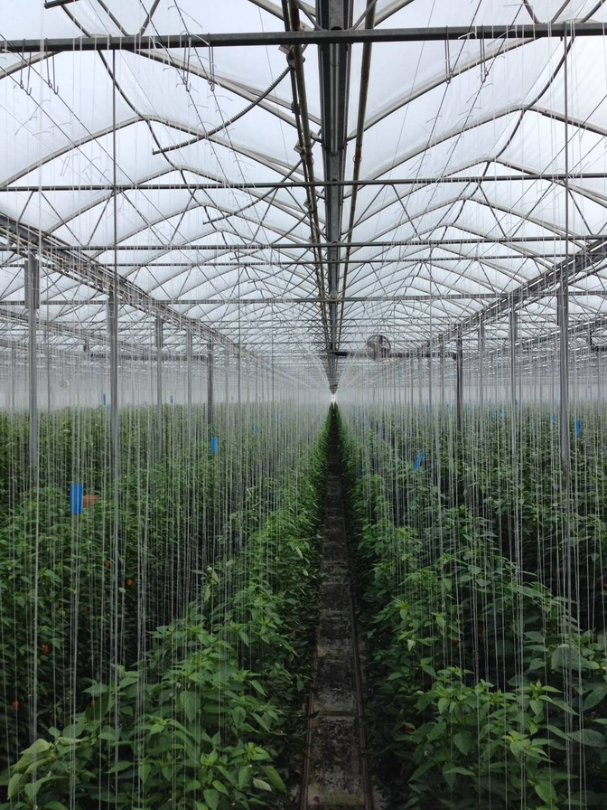
In 2019, corporations signed Power Purchase Agreements (PPAs) amounting to 20 GW across 23 countries worldwide. This figure represents about 40% of all corporate renewable energy agreements signed over the past decade.
Google became the largest corporate buyer of renewable energy in 2019, purchasing approximately 2.7 GW of clean power.
By early 2020, a total of 229 leading global corporations had joined the RE100 (Renewable Energy 100%) initiative, committing to using 100% renewable energy in their operations.
A Power Purchase Agreement (PPA) is a long-term electricity procurement contract under which a large electricity consumer — or a group of smaller consumers — agrees to purchase a specified amount of electricity directly from a power producer, typically for a period of 10 to 20 years.
RE100 is a global corporate initiative for renewable energy that brings together hundreds of major and ambitious companies committed to sourcing 100% of their electricity from renewable sources.

Slide 39
Section 3. International Experience in Government Support for Green Energy

Slide 40
Administrative Instruments
Administrative instruments refer to state regulatory measures aimed at promoting the development and use of green energy through laws, standards, permits, and mandatory requirements.
These tools ensure the implementation of environmental policies, regulate energy production and consumption, and establish institutional frameworks for sustainable development.

Slide 41

Economic Instruments
  Preferential lending programs
  State subsidies and compensations
  Investments in scientific research and experimental design projects
  Certification programs
  Implementation of energy management systems
  Grants
  Regulation of energy resource prices

Slide 42

Information Instruments.
These instruments consist of measures aimed at promoting and popularizing green energy, raising public awareness, and encouraging the adoption of sustainable energy practices.

Slide 43
Section 4. Prospects for the Development of Green Energy in Uzbekistan

Slide 44

According to calculations by European experts, Uzbekistan has the potential to generate 40 times more electricity per year than its current annual consumption volume.

Slide 45
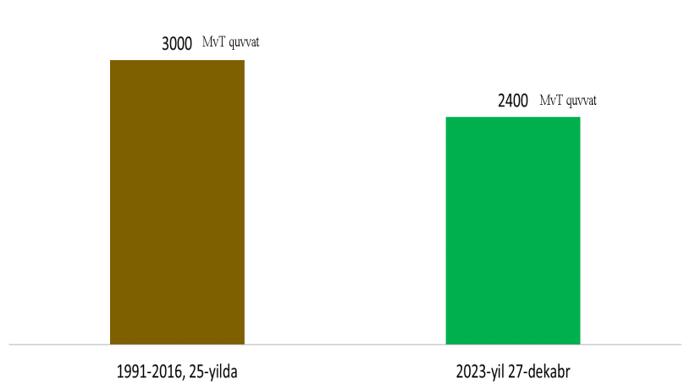
Between 1991 and 2016, a total of 3,000 MW of capacity was commissioned over 25 years,
while on December 27, 2023 alone, Uzbekistan launched six major green energy projects with a combined capacity of 2,400 MW.

Slide 46
















In recent years, the government has allocated about 1.15 billion USD in energy subsidies from the state budget — roughly 32 USD per capita.
According to official statistics, in 2022, 14.1% of Uzbekistan’s population (approximately 5 million people out of 36 million) lived below the poverty line.
If these energy subsidies were provided as direct financial assistance to low-income households, the total support would amount to:
5 million × 32 USD = 160 million USD (0.16 billion USD).
In this case, the remaining 0.99 billion USD would stay in the state budget, allowing it to be redirected toward infrastructure, green energy projects, or targeted social programs.

Slide 47
Thank you for attention!

