Slide 1

Benchmarking in the industry
Senior Lecturer, PhD. Mamajonova S.V.

Slide 2
new :
Organization of marketing activities in industrial enterprises.
The essence and tasks of benchmarking.
The process and types of benchmarking.
Benchmarking as a new method of economic analysis.

Slide 3

1. Organization of marketing activities in industrial enterprises.

Slide 4
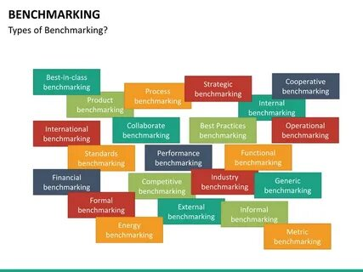
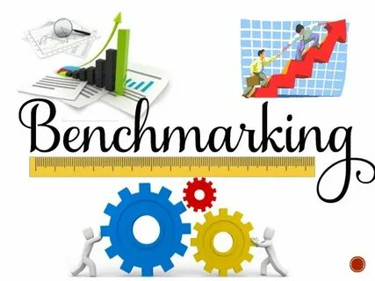
Marketing
is the most important link in the management of modern manufacturing enterprises.

Slide 5
The marketing activities of an enterprise include the following four processes: :
Development of product assortment and nomenclature
Formation of pricing policy for the product range
Organizing merchandise movement and effective sales
Market research

Slide 6
By honestly studying and assessing the current state of the market and future demand, the marketing activities of manufacturing enterprises should be directed towards the following::
to clearly define current and strategic (long-term) goals;
to determine the source of resources to achieve the set goals;
to determine the range and quality of goods and products to be produced;
to determine the optimal structure of production, supply and distribution;
to determine the expected profit
.

Slide 7
Marketing strategy is implemented in four interrelated stages:
case study
strategy development
develop a marketing program
strategy implementation

Slide 8
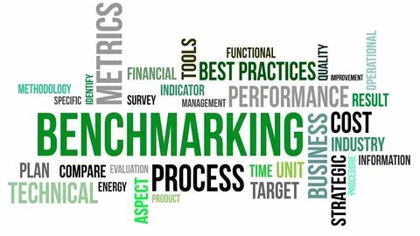
2. Benchmarking – essence and tasks

Slide 9
Benchmarking, as one of the directions of modern marketing, is gaining importance in the context of the liberalization of the national economy..
Its goal is to reliably determine the likelihood of successful development of enterprises and sustainable positive results based on research..

Slide 10
Benchmarking is increasingly being used by various companies to modify the quality of the provision of goods and services, as well as to make changes to internal business processes that ensure this quality.
The essence of benchmarking is to collect comprehensive information about the activities of various entities in the market environment, which allows you to gain a broad understanding of the nature of the entrepreneurial activities of leaders in a competitive environment and the reasons for their success, to generalize their experiences and use these experiences to build an effective business model.

Slide 11


Benchmarketing
The way leading companies work is to carefully study the products they produce and then apply their experience to their own activities.

Slide 12
Today, even the largest companies in the world are using this method. More precisely, one of the three main methods used in the field of marketing is called benchmarking. One of its most advantageous aspects is that using benchmarking, you can achieve success in a short time at low cost. Through the benchmarking method, you can not only reach the level of the copied companies, but also surpass them in terms of profit and efficiency. For this, the activities of competing companies are carefully studied, and the necessary conclusions are drawn from their successes as well as their shortcomings. In this way, a unique model of development is developed.

Slide 13
According to research conducted by researchers at the Open University Business School in the UK, healthcare is the most widely used method of benchmarking today. Specifically, 85% of healthcare providers are using benchmarking, compared to 66% in education, 62% in government, 48% in manufacturing, 32% in financial services, and 30% in services and trade.

Slide 14
Taking into account the basic principles of benchmarking - clarification, measurement, analysis, improvement and control, the company launched the production of modern "Taurus" cars that fully meet the requirements of the time and customer needs..
This effort quickly showed its positive results, and their products began to gain the attention of buyers again..

Slide 15

3.Benchmarketing process and types

Slide 16
Types of benchmarking
Internal performance benchmarking.
Benchmarking with competitors.
Functional benchmarking.
General benchmarking.
Strategic benchmarking.
Process benchmarking.
External benchmarking.
International benchmarking
.

Slide 17
Benchmarking methodology
Identify problem areas.
Identify other companies with similar processes.
Identify companies that are leaders in this field.
Research companies based on their performance metrics and practical experience in a given field.
Select appropriate indicators (benchmarks).
Identify a source for benchmarking.
Go to companies that are leaders in the field.

Slide 18

4. Benchmarking as a new method of economic analysis

Slide 19
In a market economy based on free competition, the main goal of business entities is to produce high-quality products that fully meet the requirements of world standards and extend the life cycle of their products. Effective organization of these processes requires well-established management analysis and marketing in enterprises. In world practice, new methods are being developed and put into practice to analyze marketing activities. One of these analysis methods is benchmarking.

Slide 20
Benchmarking analysis method was created in 1972 by the US consulting organization PIMS. Since 1979, the US company XEROX, in collaboration with Japanese organizations, began to implement the Benchmarking project in countries around the world for the purpose of analyzing costs and product quality.
The term "benchmarketing" is formed from the combination of the English words "bench" - "place, place", "to mark" - "to mark", and is a method of determining the optimal volume of production and sales of products, taking into account the internal capabilities of the enterprise and the factors of the market mechanism, that is, determining its position in the market.
Benchmarketing analysis is a long-term prospective analysis, which is used to analyze not only the activity, but the entire activity of the enterprise for an unlimited period of time.

Slide 21
The main goals of benchmarking analysis are:
Increasing the profitability and efficiency of enterprise activities
Make quick decisions and change them
Setting flexible goals
Development and implementation of innovative ideas
Constantly maintaining the company at a stable pace
Establishing a competitive entity
Expanding the company's market share
Assessing one's own performance against global standards
Create the opportunity to accept additional orders depending on changing market conditions

Slide 22


Benchmarking analysis is carried out in three stages.
The first stage is the planning stage.
The second stage is the analysis stage.
The third stage is the implementation of the developed plan into the activities of the enterprise.

Slide 23

Four types of benchmarking are widely used in world practice.

Slide 24
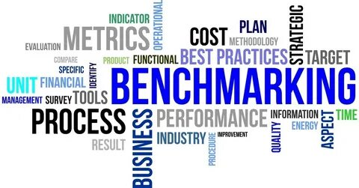
Competitive benchmarking
General benchmarking
Internal benchmarking
Functional benchmarking

Slide 25
THANK YOU FOR YOUR ATTENTION

