Slide 1
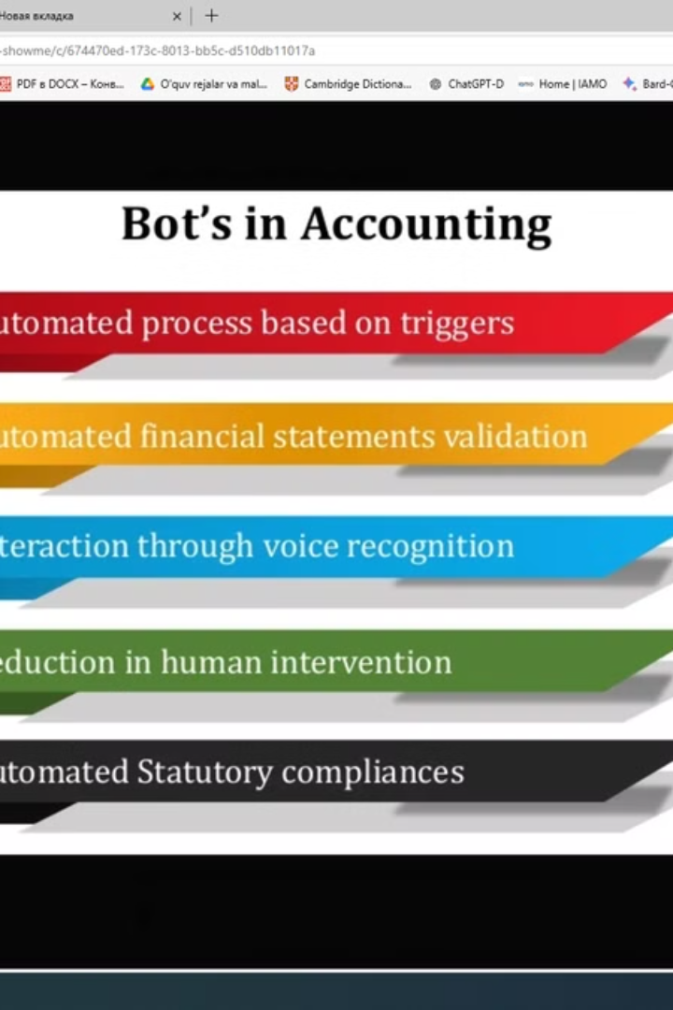
Accounting and Audit: The Digital Transformation
This presentation explores the profound impact of digitalization on the accounting and auditing landscape. We'll delve into key areas of transformation, including blockchain technology, automation, and the rise of continuous auditing.
by Gayrat Berdiyev

Slide 2
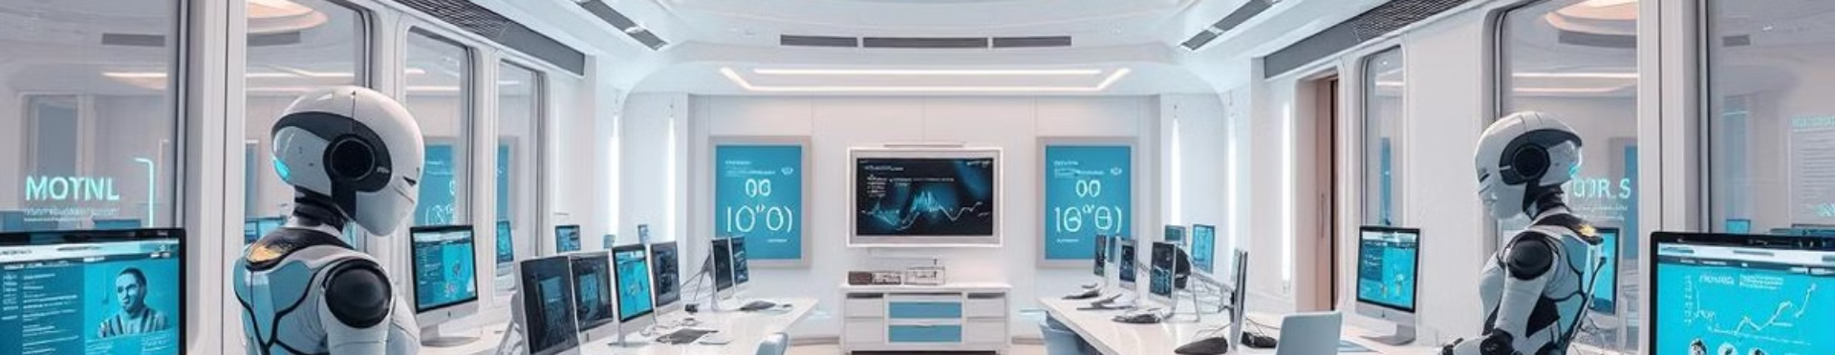
The Rise of the "Smart Firm"
The traditional power struggle between owners and managers is being disrupted by the emergence of the "smart firm." This concept envisions artificial intelligence as the driving force behind corporate decisions, potentially leading to a new paradigm for accounting and auditing.

Slide 3
Digitalization: A Multifaceted Revolution
Industry 4.0
Opportunities and Challenges
The digital economy, characterized by Industry 4.0, embraces technologies like the Internet of Things (IoT), Cyber Physical Systems (CPS), and intelligent factories. These advancements aim to optimize industrial production, engineering, and supply chains.
Digitalization offers benefits like enhanced transparency, accuracy, and reduced costs. However, it also presents complexities, legal uncertainties, and the need for new standards and trust frameworks.

Slide 4
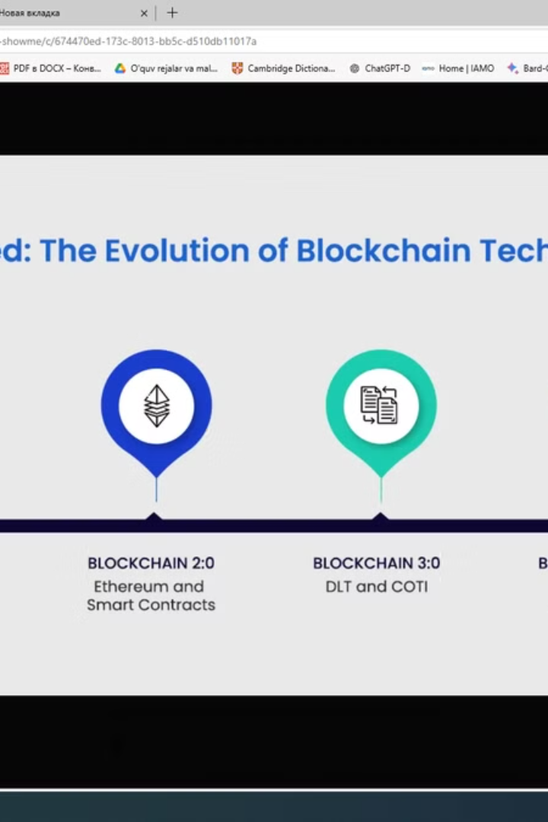
Digitalization's Impact on the Accounting Pyramid
Blockchain
Robotics
Blockchain technology offers potential for streamlining accounting and auditing by creating a secure, transparent, and tamper-proof ledger for transactions.
Automation through robotics can significantly enhance efficiency in accounting operations by automating repetitive tasks, freeing up accountants for more strategic roles.
Digital Twins
Digital twin technology creates real-time digital representations of physical assets, leading to improved inventory management, operational efficiency, and enhanced financial reporting.

Slide 5

Blockchain's Potential for Accounting and Auditing
Blockchain's distributed, transparent, and tamper-proof nature promises to revolutionize accounting and auditing. It could enhance trust, reduce fraud, and create new opportunities for efficiency and transparency.

Slide 6

The Evolution of Blockchain Technology
1
Blockchain 1.0
Cryptocurrencies represent the first wave of blockchain adoption, enabling secure and transparent digital transactions.
2
Blockchain 2.0
Smart contracts extend blockchain's capabilities to automate and enhance various economic and financial transactions, including asset management and agreements.
3
Blockchain 3.0
The "smart firm" concept envisions a future where blockchain powers automated operations, decision-making, and organizational structures, creating a new era for business.

Slide 7

The Rise of Accounting Robotics
Robotic Process Automation (RPA) is transforming accounting by automating routine tasks and freeing up human resources for more strategic roles. This automation can significantly improve efficiency and accuracy.

Slide 8

The Impact of Digital Twins on Accounting
Digital twin technology creates digital replicas of physical assets, enabling real-time monitoring, data analysis, and improved inventory management. This can streamline accounting operations and enhance financial reporting.

Slide 9




The Future of Auditing: Continuous and Intelligent
Real-Time Monitoring
Continuous auditing allows for real-time monitoring and verification of data, ensuring timely identification of anomalies and risks.
Data-Driven Insights
Advanced analytics and AI-powered tools can provide deeper insights into business operations, identifying potential issues and improving risk management.
Automated Processes
Automation of audit procedures through AI and blockchain can significantly reduce human error, improve efficiency, and enhance audit quality.

Slide 10

Key Takeaways and Next Steps
Digitalization is transforming the accounting and auditing landscape. Embracing blockchain, robotics, and continuous auditing is crucial for organizations to stay ahead. We must adapt our education systems, professional development, and regulatory frameworks to navigate this evolving world.

