Slide 1
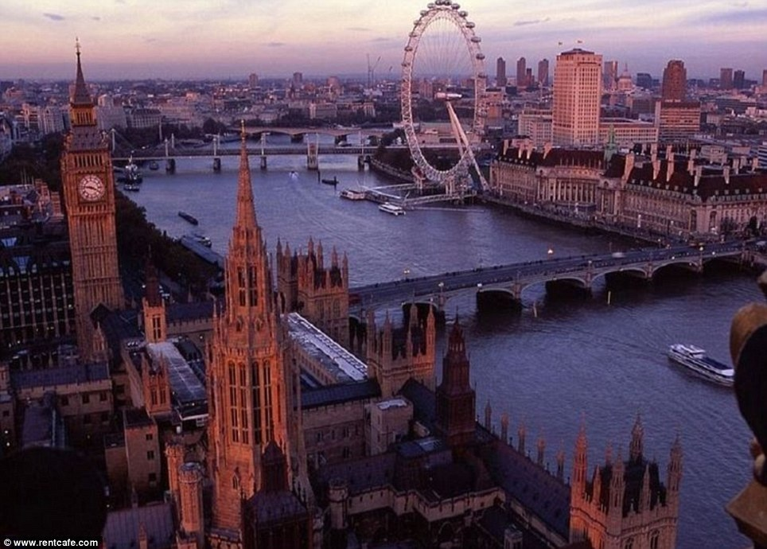
Exploring the world’s iconic cities
This Photo by Unknown Author is licensed under CC BY

Slide 2
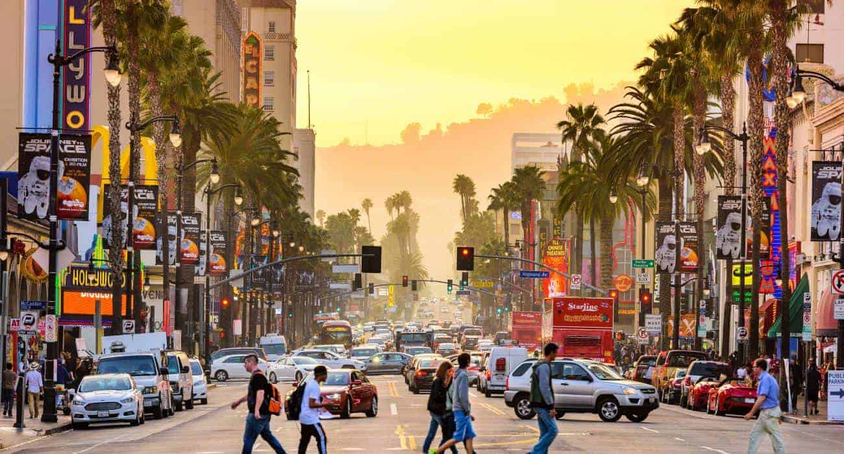
Introduction to iconic cities
In this presentation , we will explore iconic cities around the world, examining their cultural significance, historical importance, and unique characteristics. From ancient landmarks to modern architecture , each city offers a distinct narrative that contributes to its global identity.
This Photo by Unknown Author is licensed under CC BY-NC-ND

Slide 3

Each city has its own unique charm and attractions, drawing in millions of visitors each year. Whether you're a history buff, a foodie, or a nature lover, there is something for everyone in these cities
Join us on a journey as we explore the rich culture, history, and beauty of these Famous Cities. Get ready to be inspired and amazed by the wonders that these cities have to offer

Slide 4
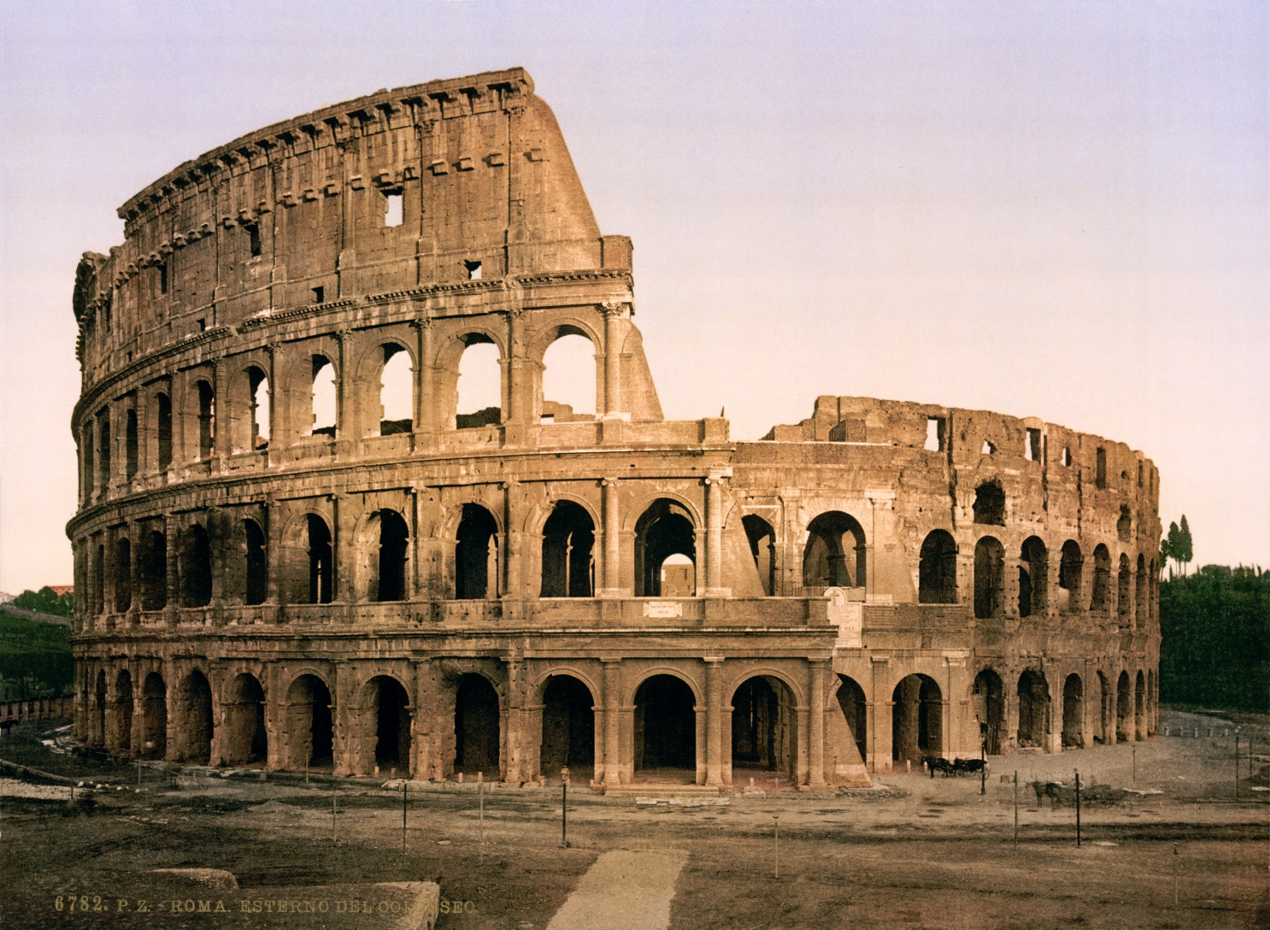
Rome: Eternal city
Rome, known as the eternal City , is rich in history and architecture . From the Colosseum to the Vatican , every corner tells us a story of its ancient civilization, making it a must-visit for history enthusiasts and travelers alike.
This Photo by Unknown Author is licensed under CC BY-SA

Slide 5
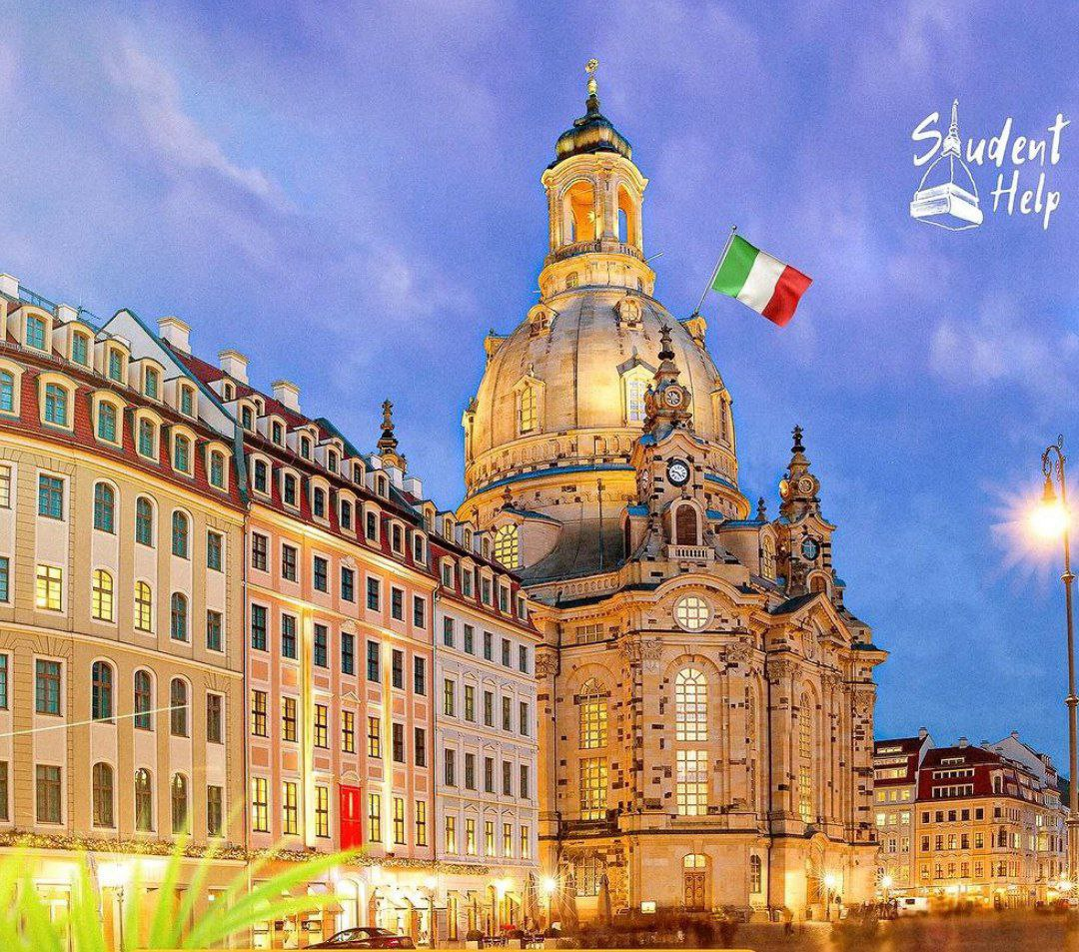
Exploring the Historical Streets of Rome
When visiting Rome, one cannot miss exploring its historical streets filled with ancient ruins and majestic structures. Walk along the cobbled pathways lined with iconic landmarks like the Colosseum and Pantheon

Slide 6
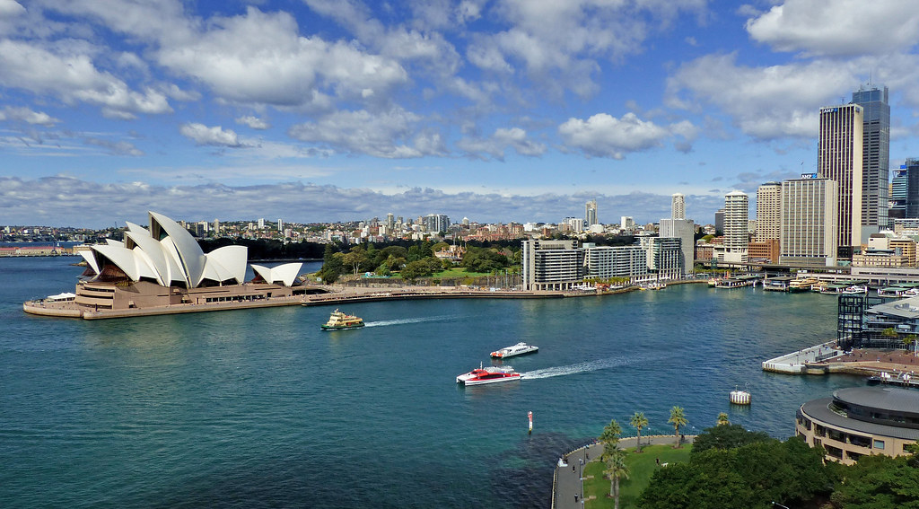
Sydney: The harbor city
Sydney is renowned for its stunning harbor , beaches, and the iconic Sydney opera house . The outdoor lifestyle and cultural festivals reflect the laidback yet vibrant Australian spirit , attracting visitors from around the globe .

Slide 7
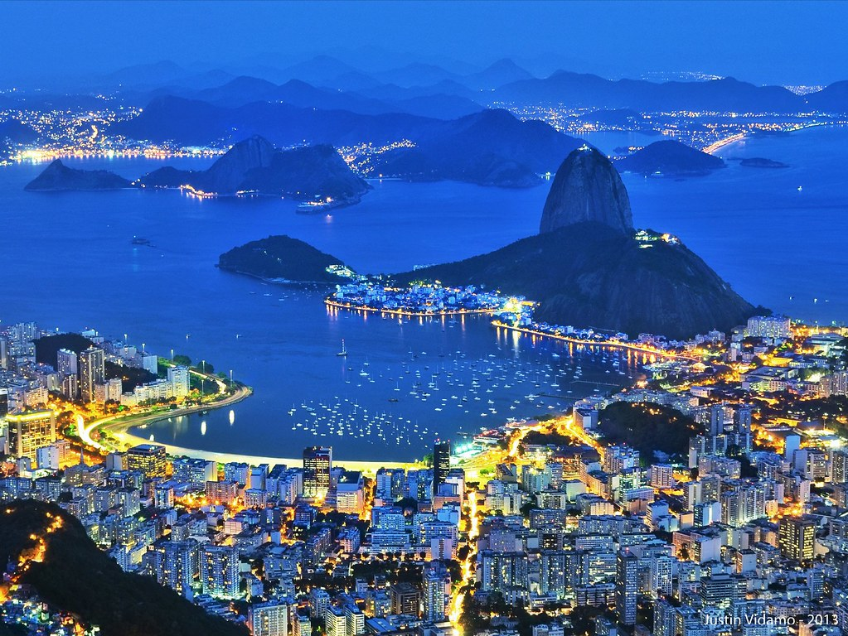
Reo de Janeiro : The Marvelous City
The city known as the Marvelous City, is famous for its carnivals, beaches, and the iconic Christ the Redeemer statue.
The vibrant culture and breathtaking landscape make it a unique destination in south America.
This Photo by Unknown Author is licensed under CC BY

Slide 8
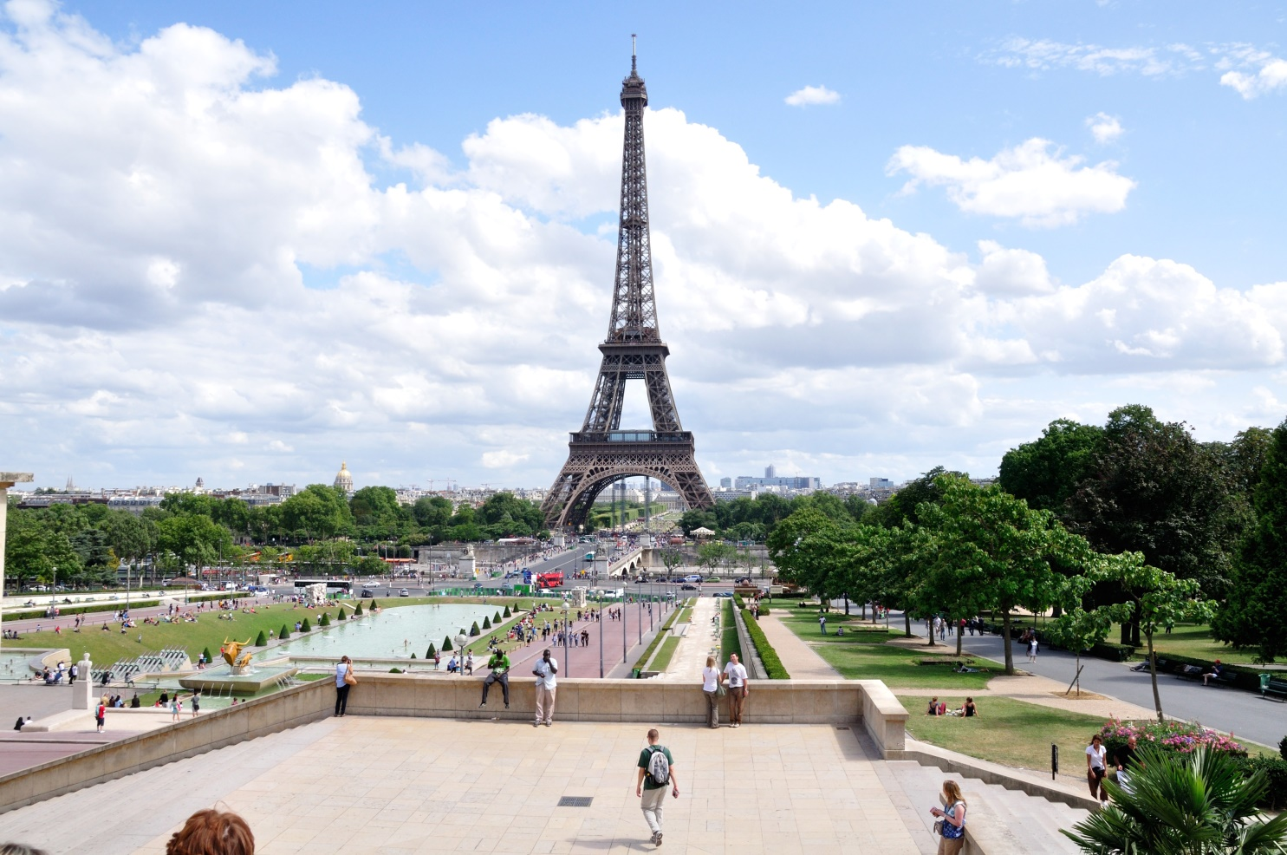
Paris : The city of light
Paris, known as The city of light ,is famous for its art, fashion ,and culinary delights. The Eiffel Tower and Louvre Museum are two of its many attractions that draw millions of visitors each year , embodying the essence of French culture.
This Photo by Unknown Author is licensed under CC BY-SA

Slide 9
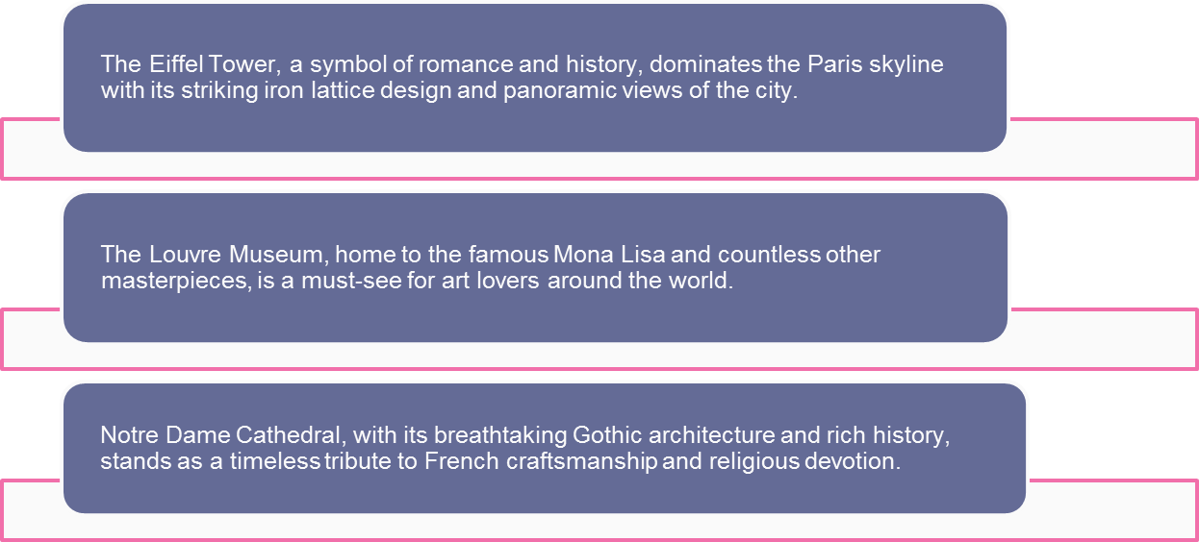

Slide 10
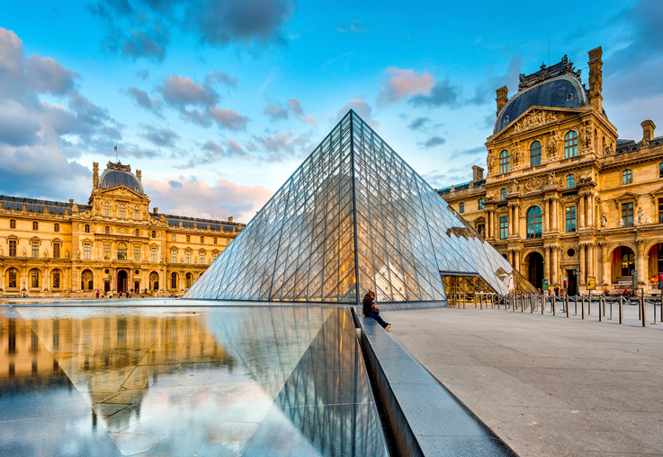
The Louvre is the main landmark of Paris. It is one of largest museums in the world. The museum is situated in the Louvre Palace, which was once a fortress

Slide 11
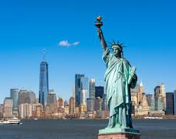
New York City: The City that Never Sleeps
New York City, famously known as 'The City that Never Sleeps', is a bustling metropolis filled with endless energy and diverse cultural attractions

Slide 12
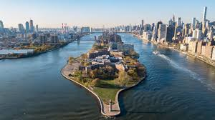
More than 50 million people visit New York City every year. The five boroughs or regions of New York have some of the most easily recognized attractions in the world. Visitors on a budget can take a free boat from Manhattan to Staten Island for a great view of the Statue of Liberty and the Manhattan skyline

Slide 13


Slide 14


Slide 15
Conclusion : A Global Tapestry
In conclusion ,exploring these iconic cities reveals a global tapestry of culture , history, and innovation . Each city contributes uniquely to our understanding of world.

